Slide 1
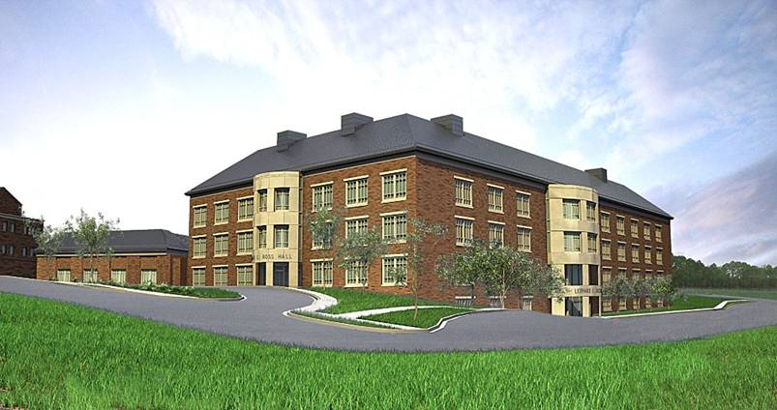
2012 AAP Pre-Doctoral Workshop “Vertical Integration of Periodontics Throughout the Four Year Curriculum” The Periodontics Faculty Role
Dr. Grishondra Branch-Mays
Chair, Surgical Sciences
East Carolina University
School of Dental Medicine

Slide 2
East Carolina University School of Dental Medicine
Our Vision:
Improving the health and quality of life of all North Carolinians by creating leaders with a passion to care for the underserved and by leading the nation in community-based, service learning oral health education.

Slide 3
Our Mission
Prepare leaders with outstanding clinical skills, an ethical bearing, sound judgment and a passion to serve;
Provide educational opportunities for individuals from historically underrepresented groups, disadvantaged backgrounds and underserved areas;
Provide and enhance oral health services for underserved North Carolinians through implementation of community-oriented service learning and interprofessional collaborations;
Foster an environment where creativity, collaboration and diversity are embraced;
Guide future clinical practice and dental education through innovation and discovery.

Slide 4
Educational Priorities
52 pre-doctoral dental students per year
4-5 General Practice Residents per year
Up to 22 Advanced Education in General Dentistry (AEGD) residents per year
3-4 Pediatric Dental Residents per year
Continuing education for dental professionals
Oral health promotion - general public

Slide 5
“The ECU Model”
Primary Care
Increasing Access: educating/providing care
Traditional Values: education/service/research
Facilities:
Greenville
Ross Hall
Community Service Learning Centers (10)
Across the state in rural/underserved communities
Curriculum/Use of technology
All students from NC

Slide 6
Ross Hall
Two lecture halls plus small group seminar rooms
State-of-the-art preclinical simulation labs
Clinical space for about 52 dental students per year, Pediatric dentistry residents, AEGD residents and faculty/staff
Clinical and educational support areas
Offices and conference/seminar rooms
Special needs and clinical research suite
Shelled-in space – room for expansion, research and/or more faculty offices

Slide 7
Ross Hall

Slide 8
Classroom

Slide 9
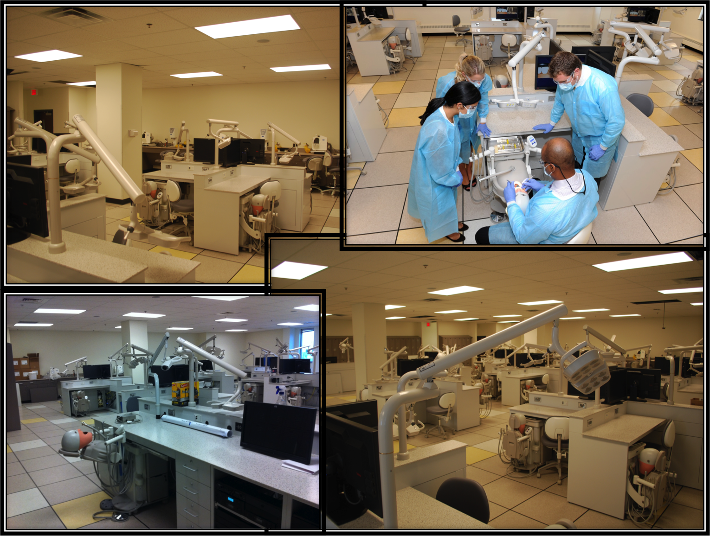
Simulation Lab

Slide 10
Community Service Learning Centers: “The ECU Model”
Community-based, economically sustainable dental practices of the School of Dental Medicine where students will advance their skills and knowledge under the supervision of dental faculty while living in rural areas across North Carolina.
Education  Access  Sustainable

Slide 11
Community Service Learning Centers
4th Floor Concept
Traditional vs. Medical Education
Partnership/Collaboration
Regional Approach
Safety Net Provider
Education  Access  Sustainable

Slide 12
Support
Practitioners
Resource to State
Economic Impact
Referral
Resource
Increase Healthcare Infrastructure
Support
Patient Care Experience
Return to Rural Area
Selection
Tele-dentistry
Work with
Auxiliaries
University Presence
Create Jobs
Continuing
Education
More Clinical Experience
Relate directly with Rural Patient Needs
Mentoring
Observe County
Board of Health
More
Diagnostic Experiences
Community Outreach
CSLCs..
The Hypothesis
Hands on Practice Management
Interprofessional Collaboration with
Primary Care Partners
Live in
Rural Areas
Community
Experiences
Actual Practice
Experience
Medicaid
See Faculty
Actually Practice
Business
Office
Dental Student
Patients
Safety Net
Assist Faculty
Pipeline Development
Remove Part of
4th Year Expense
Multiple Locations
Comprehensive
Care
Access to Care
Cost of
Dental Education
Faculty Produce
Income

Slide 13
Community Service Learning Centers
Faculty
Practicing general dentist
Community dentists
Residents
2 AEGD residents
Predoctoral Students
4-5 per site, each student rotates to three sites
Staff
Business manager and staff
Dental assistants
Hygienists
Patient coordinator/dental social worker

Slide 14
Ahoskie Community Service Learning Center

Slide 15
Department of Surgical Sciences
Division of Endodontology
Division of Periodontology
Division of Oral Maxillofacial Pathology
Division of Oral Maxillofacial Surgery
Basic Science Instruction

Slide 16
Division of Periodontology

Slide 17
Technology
“Innovation With a Purpose”
Use is NOT an option
All Apple (MacBook, iPad, iPhone)
State-of-the-Art Clinical Technology
7 iBook Platforms (facilitate problem-solving in class, chairside and at home)
Yammer
New Learning Management System (LMS)
Robust connectivity to CSLCs

Slide 18
Curriculum
Collaborative learning through case-based seminars
Weekly grand rounds and cumulative reflection
Systems-based, clinical integration approach to basic science education
CSLC with distance learning technology

Slide 19
Curriculum
Foundational Biological Sciences
Dental Care Foundations
Clinical Practice of General Dentistry
Community Oral Health Practice
Assessment and Treatment

Slide 20
Curriculum
Faculty Calibration

Slide 21
Faculty Role D1 Year
Multidisciplinary Module
Periodontology Modules-Lecture
Preclinical Instruction
Small Discussion Groups

Slide 22
Faculty Role D2 Year
Periodontology Module-lecture
Small Discussion Groups
Surgical Simulation Labs
Clinic

Slide 23
Faculty Role D3 Year
Clinic
Seminars

Slide 24
Faculty Role D4 Year
Clinic

