Slide 1
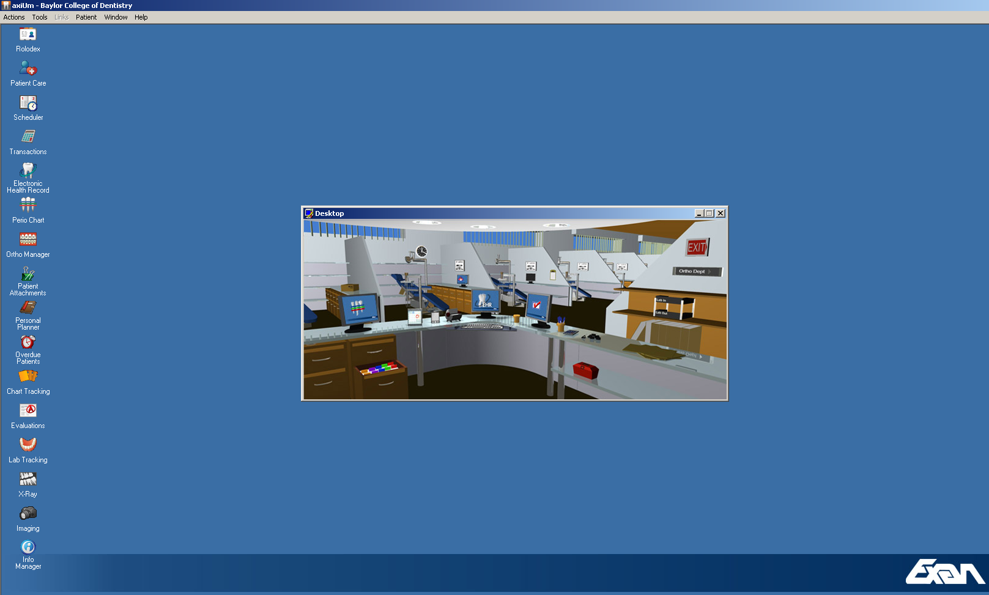


Resident
Assessment

Slide 2
Use Axium Data
Create Grade Report with your Axium Administrator

Slide 3
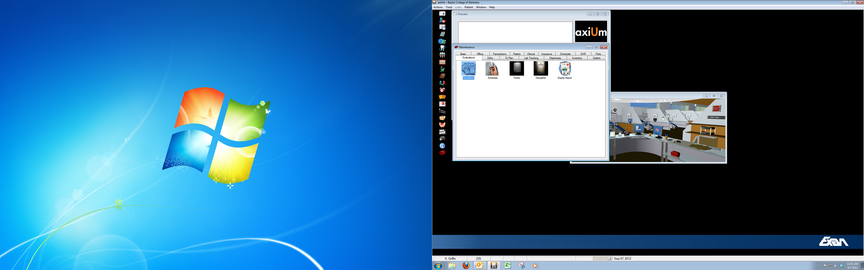
You need someone that can get you to this screen. They have administrative rights to Axium!

Slide 4
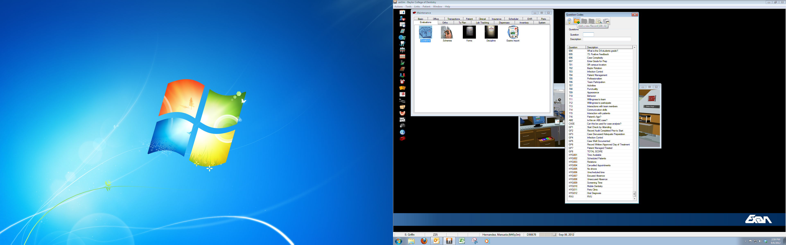
Click on the red tool box (bottom left). “Questions” will pop up.

Slide 5
Click on “Questions” – set up your assessment questions with 0=No or 1=Yes answers

Slide 6
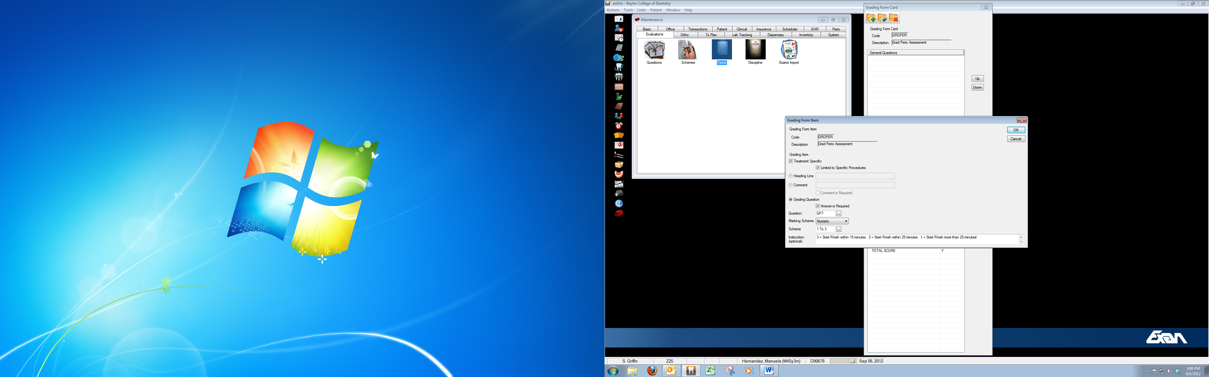
Maintenance/Evaluations/Forms – create a new form using the assessment questions you created. Be sure you assign them a Marking Scheme with instructions to standardize your assessment.

Slide 7
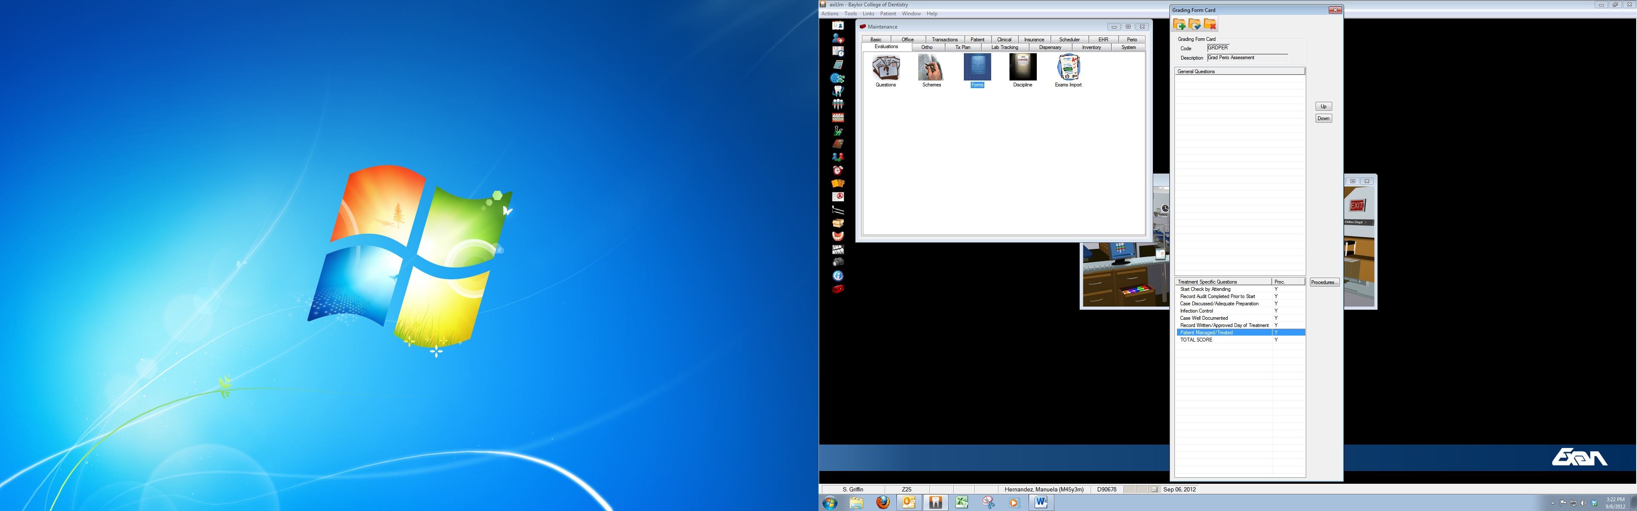
By making it “Treatment Specific” and “Limited to Specific Procedure” you will be able to assign these questions to the specific procedures you want to assess and they will appear on the grade card for these procedures only.

Slide 8
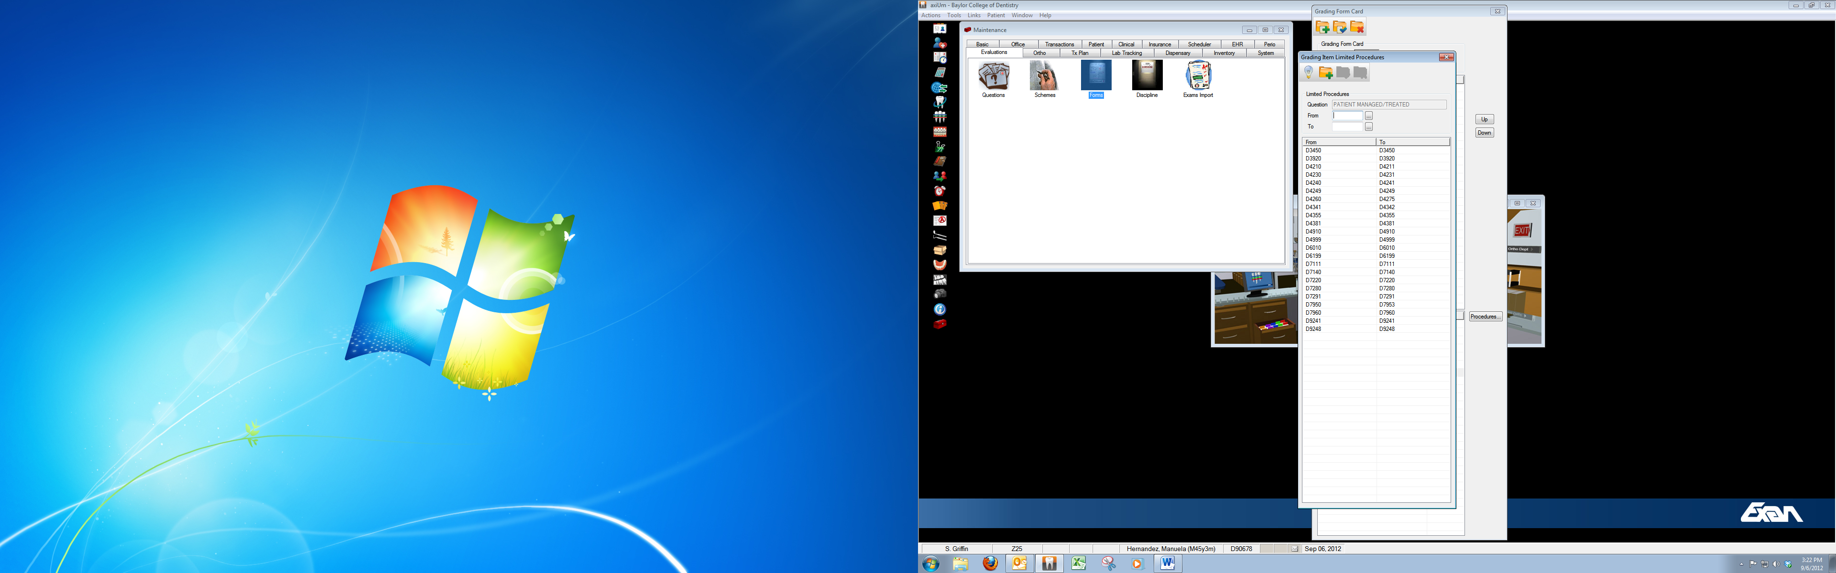
Click on “procedures” and you assign these questions to the specific procedures you want to grade.

Slide 9
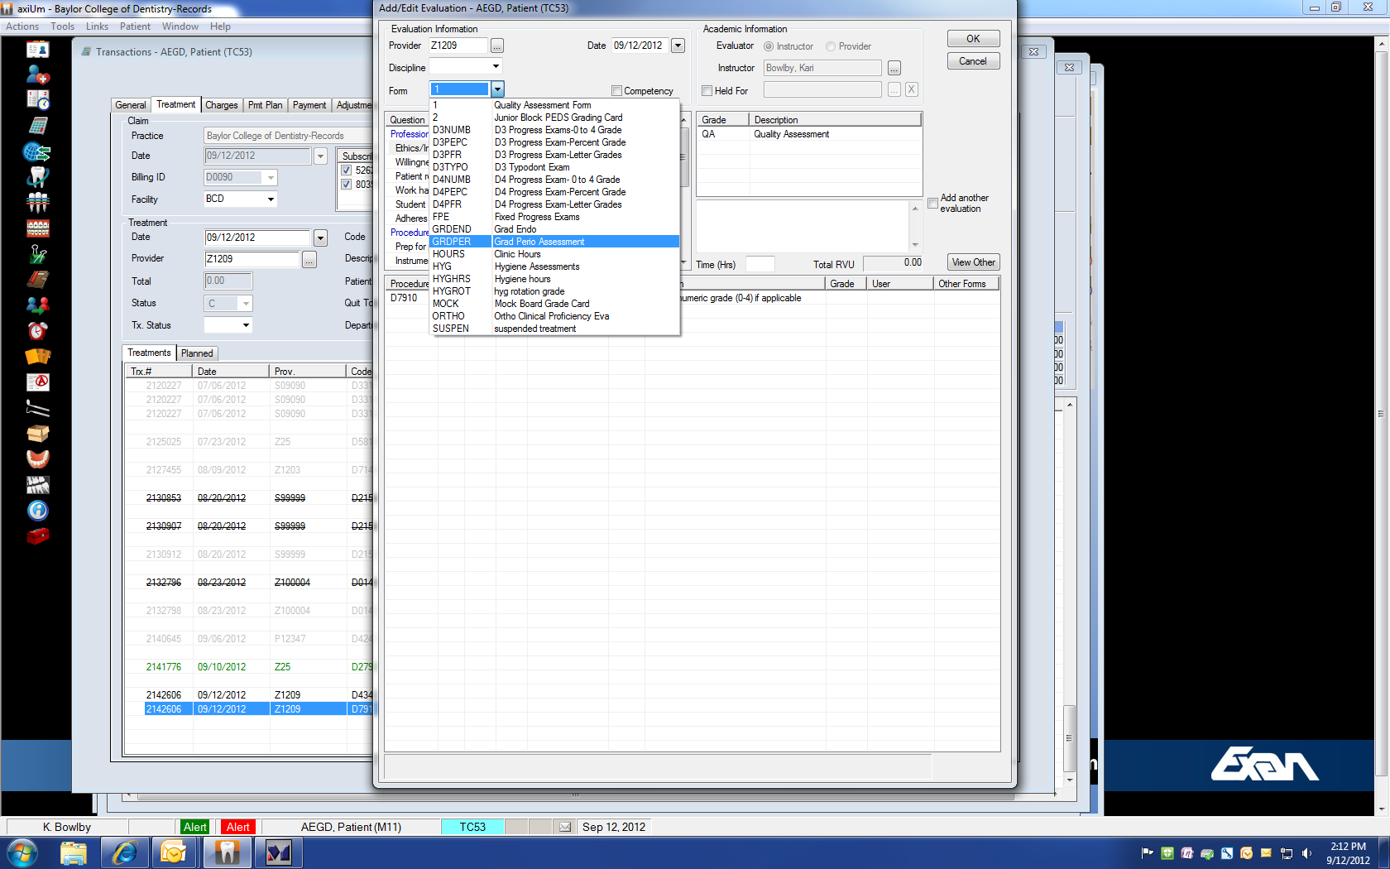

Slide 10
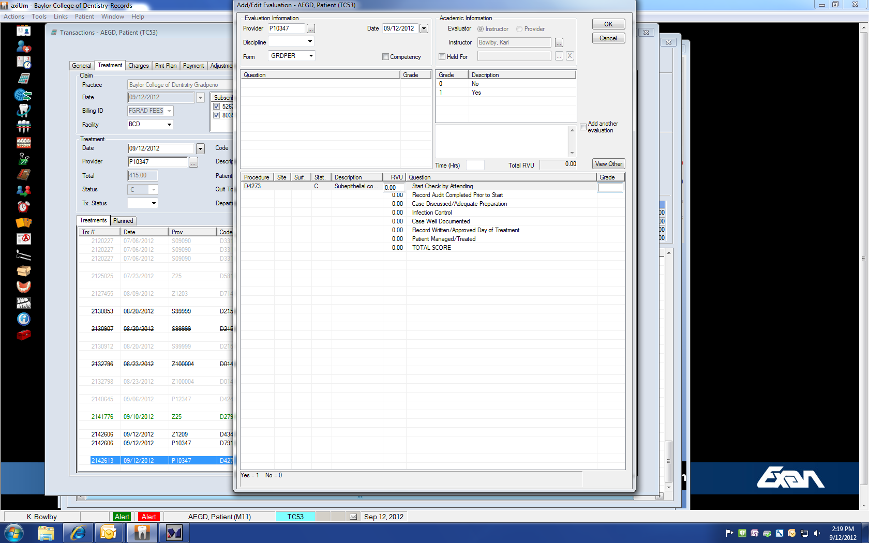

Slide 11
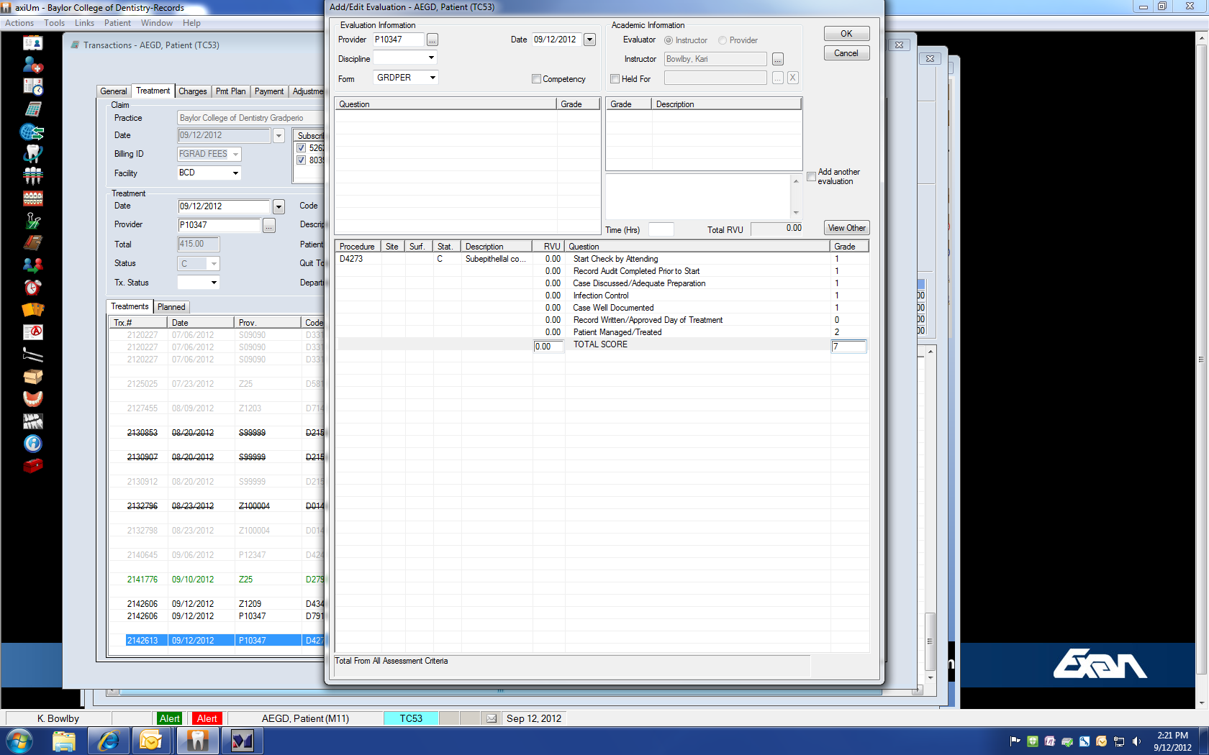

Slide 12
No or Yes (0 or 1)
The parameters you choose for faculty to evaluate in Axium requires a faculty ID card swipe to complete treatment.
The faculty must grade the procedures you define and you can retrieve a report to show each resident. That makes is much easier to evaluate for me at semi-annual evaluations.

Slide 13
Example
“You had 12 surgery cases that you had the faculty evaluate the day of treatment out of 39 cases from Jan 1 to Mar 31, 2012. Two of the cases, the date of evaluation was 45 days after treatment”
Pretty self-explanatory: documents the resident is bad about writing records day of treatment. Makes it easy for me to write their evaluation. I merely state the facts.

Slide 14
Axium Reports
How to create a grade report

Slide 15

Find evaluated procedures
Go to home screen

Slide 16
Go to Home Screen
Click on “Info Manager” (bottom left corner)

Slide 18
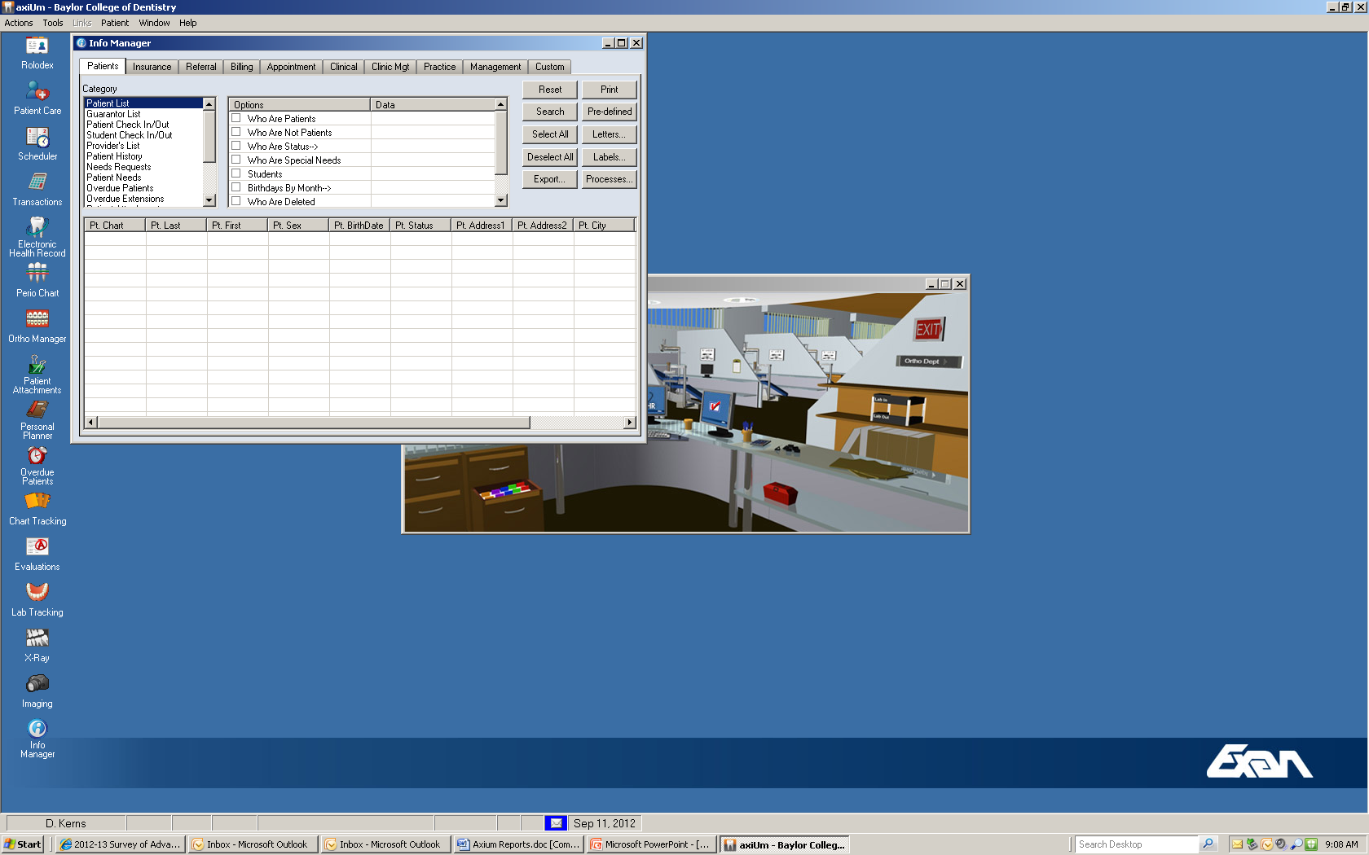
Click “Clinical” tab

Slide 19
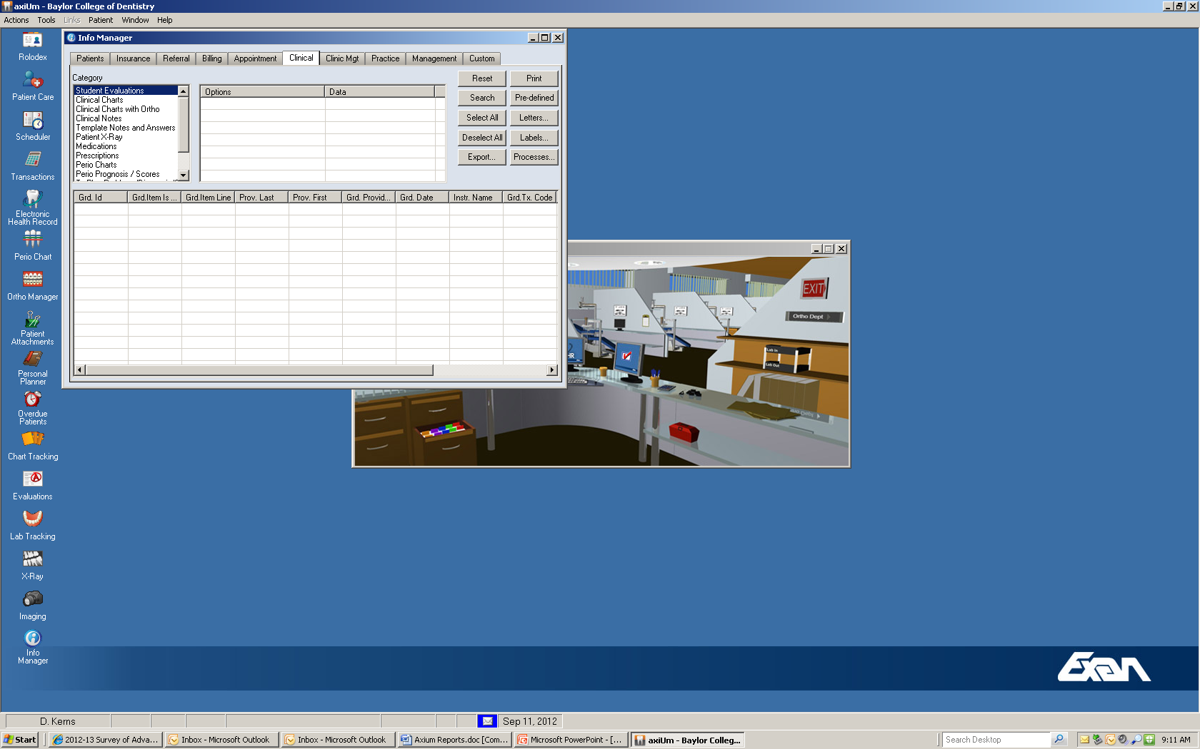
Click “Student Evaluations”

Slide 20
Next Click “Predefined”

Slide 21
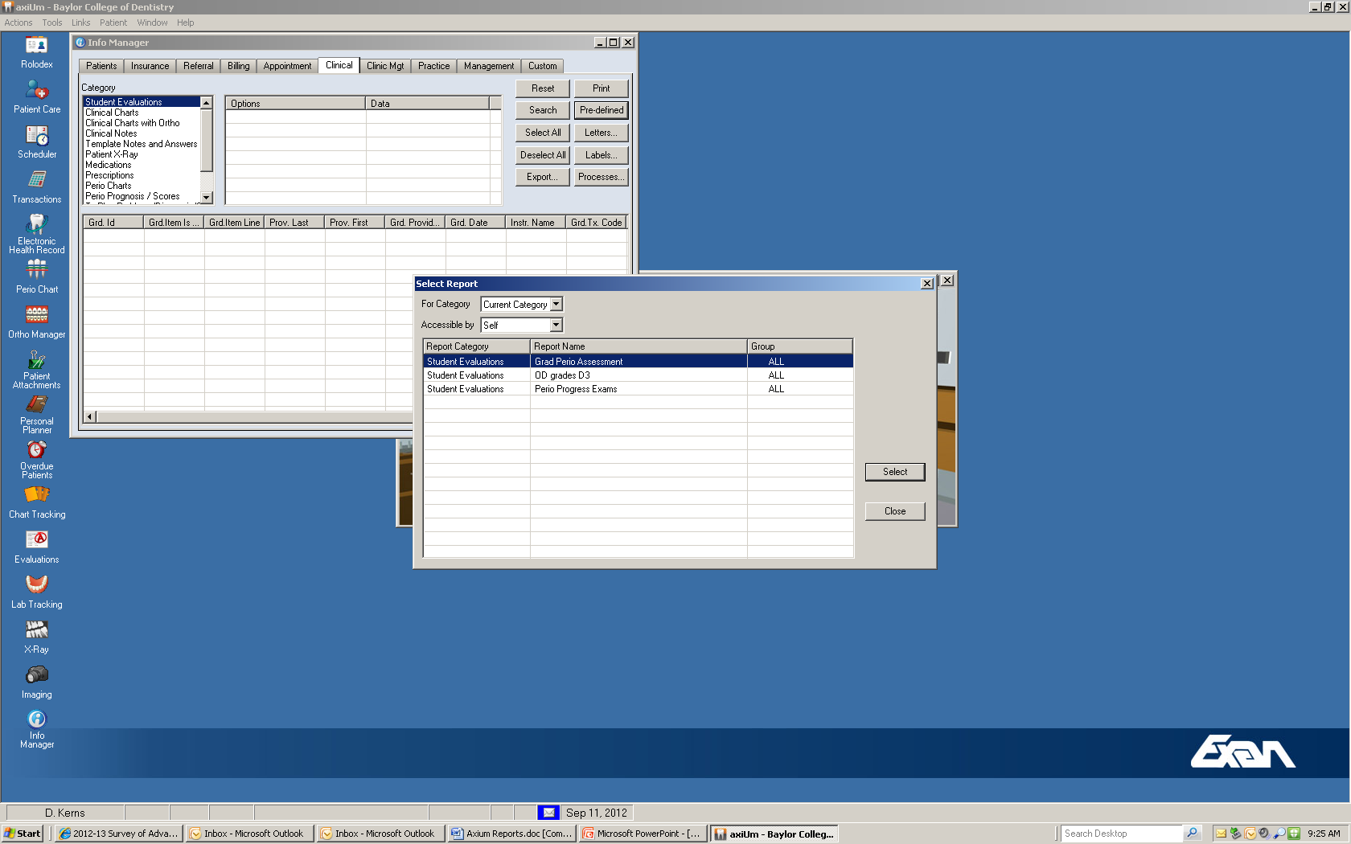
Click “Grad Perio Assessment” and click “Select”

Slide 22
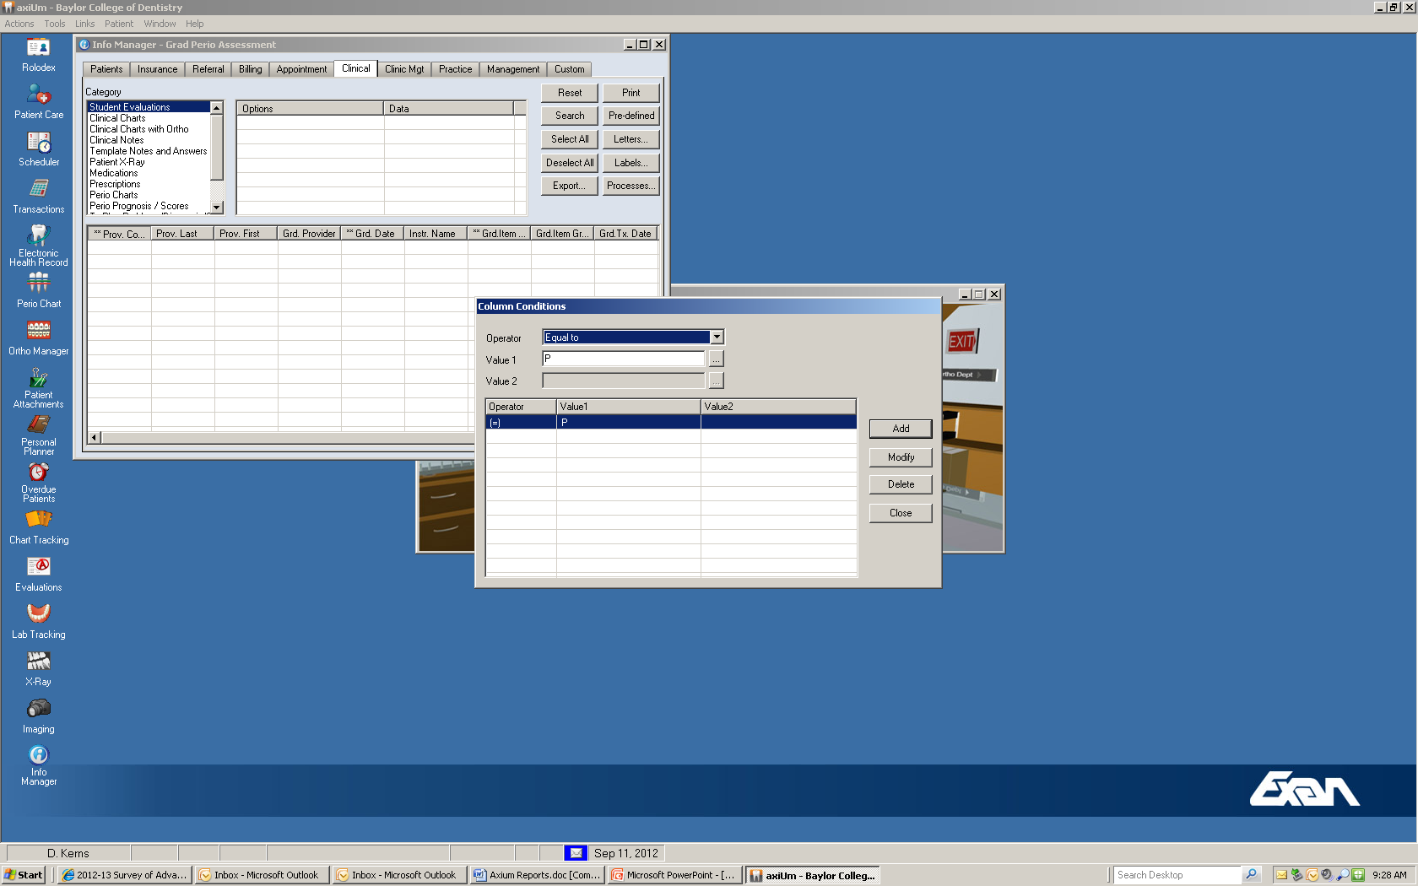
Left click “Provider code”

Slide 23
At value 1 enter resident “ID number” and click “Modify” then “Close”

Slide 24

Click “Search”

Slide 25
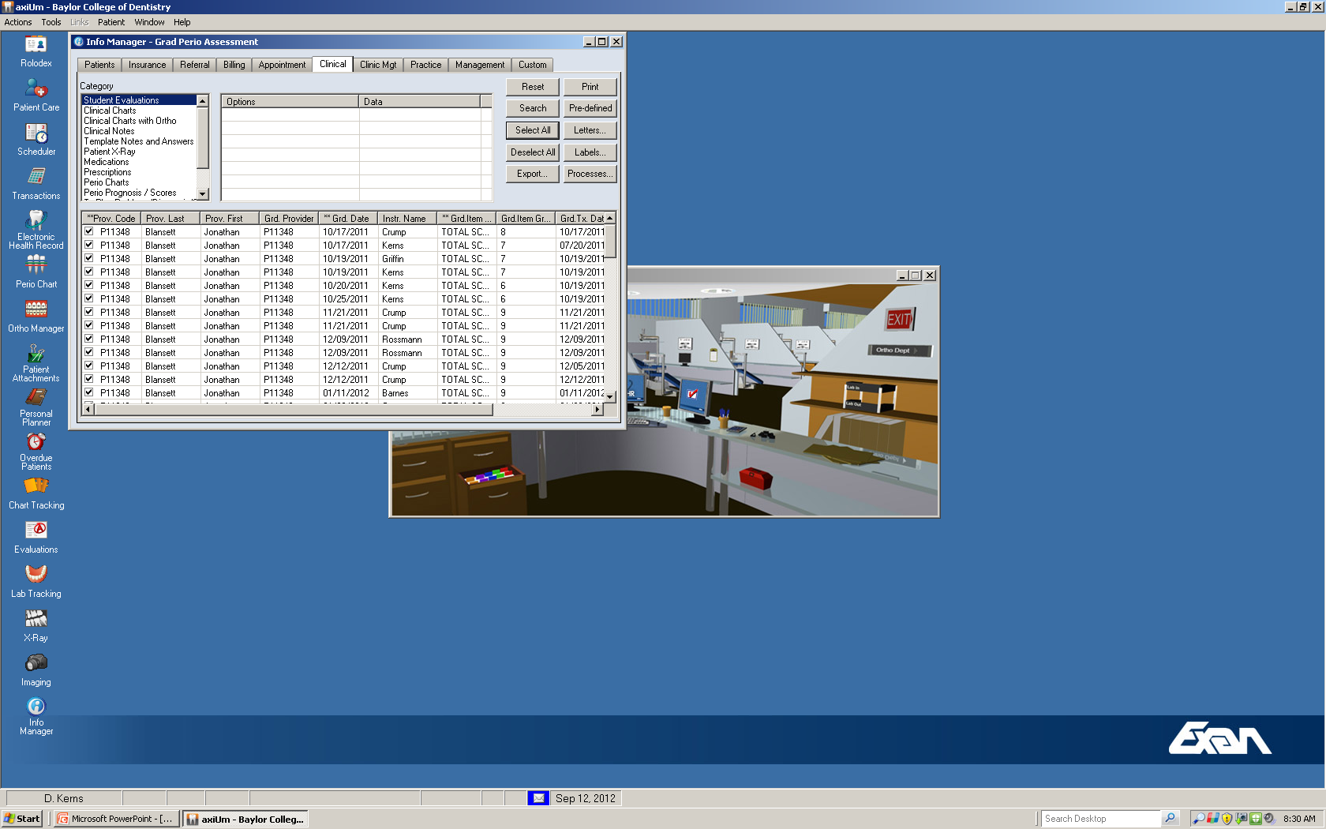
Click “Select all”

Slide 26
Click “Export”

Slide 27
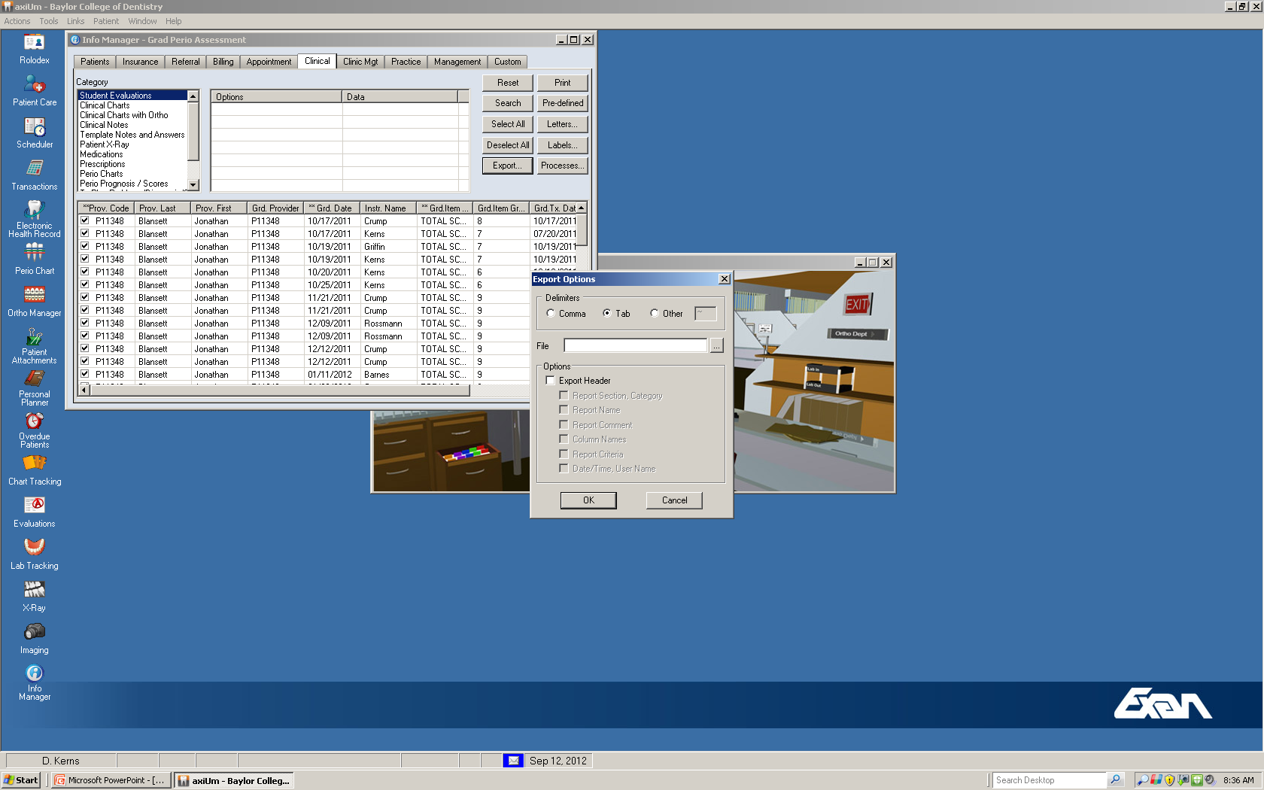
Select “Tab”

Slide 28
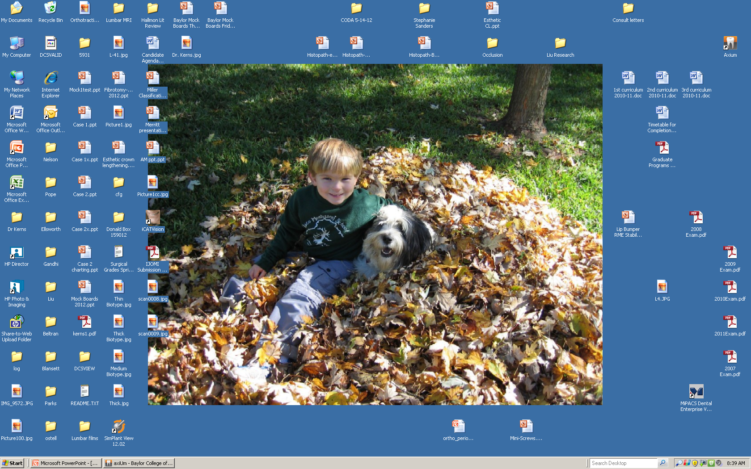
Open a file on Desktop with Resident Name

Slide 29
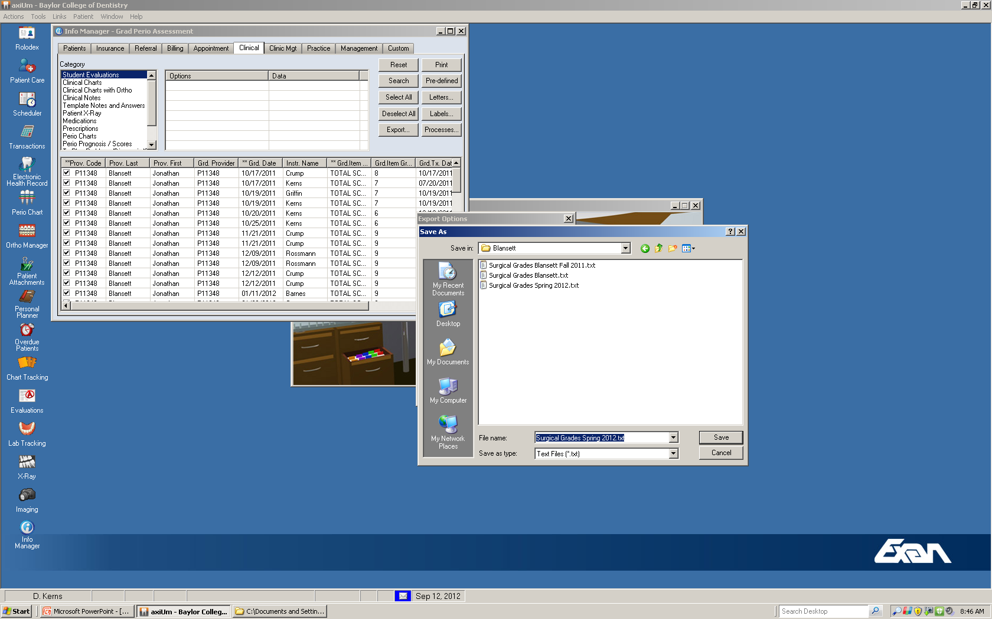
Enter “File name” and save as “Text Files”

Slide 30

Click “OK” on next screen

Slide 31
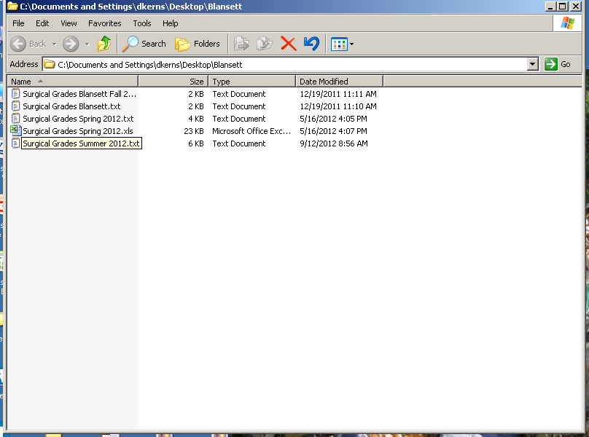
Open Resident file on Desktop

Slide 32
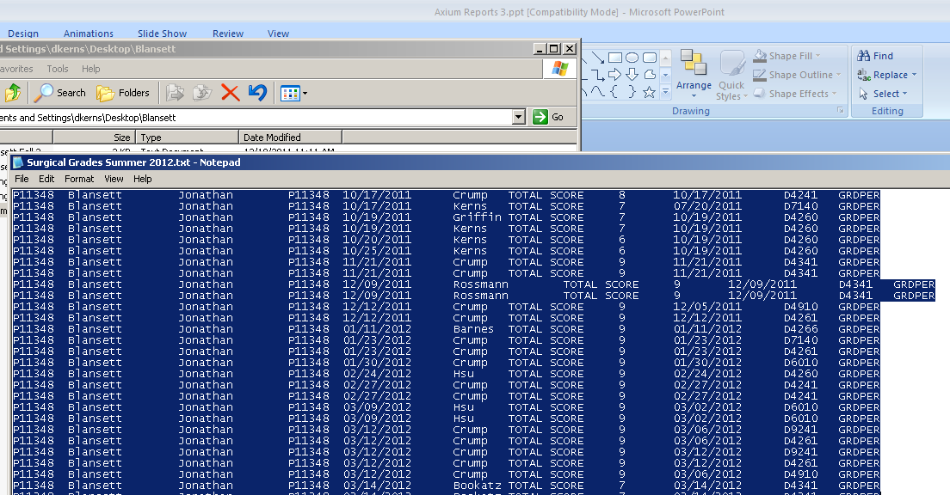
Highlight and copy all

Slide 33
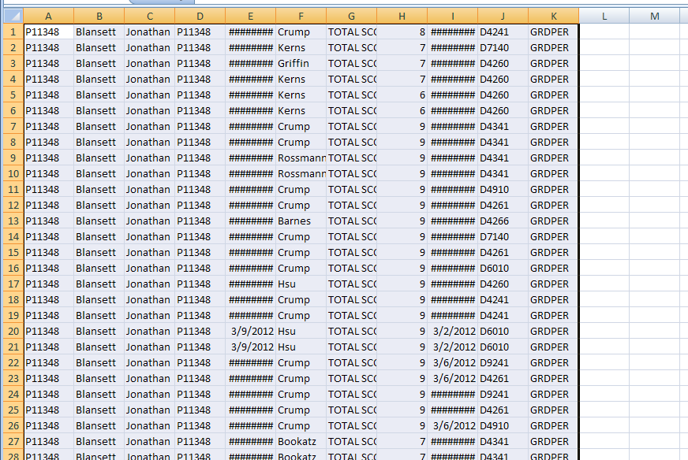
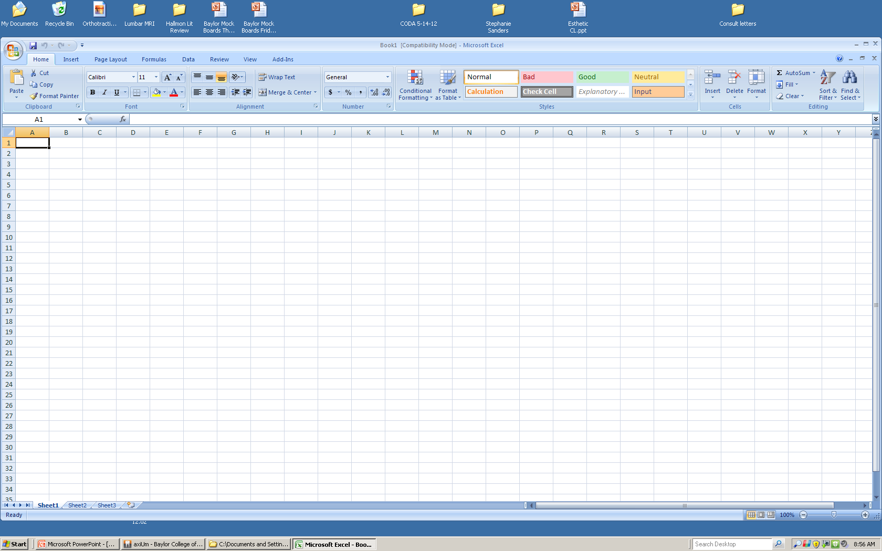
Open a blank Excel spreadsheet. Right click and paste

Slide 34
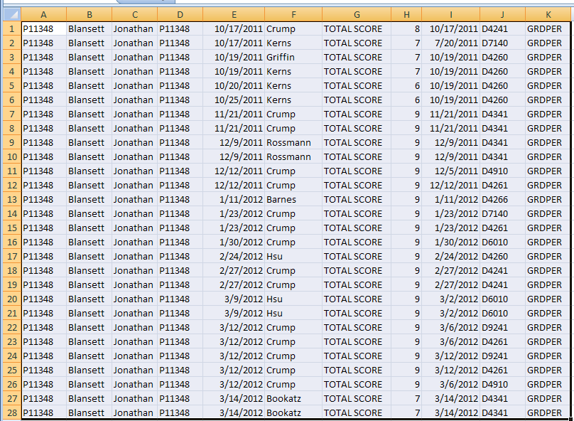
Expand columns so all info appears

Slide 35
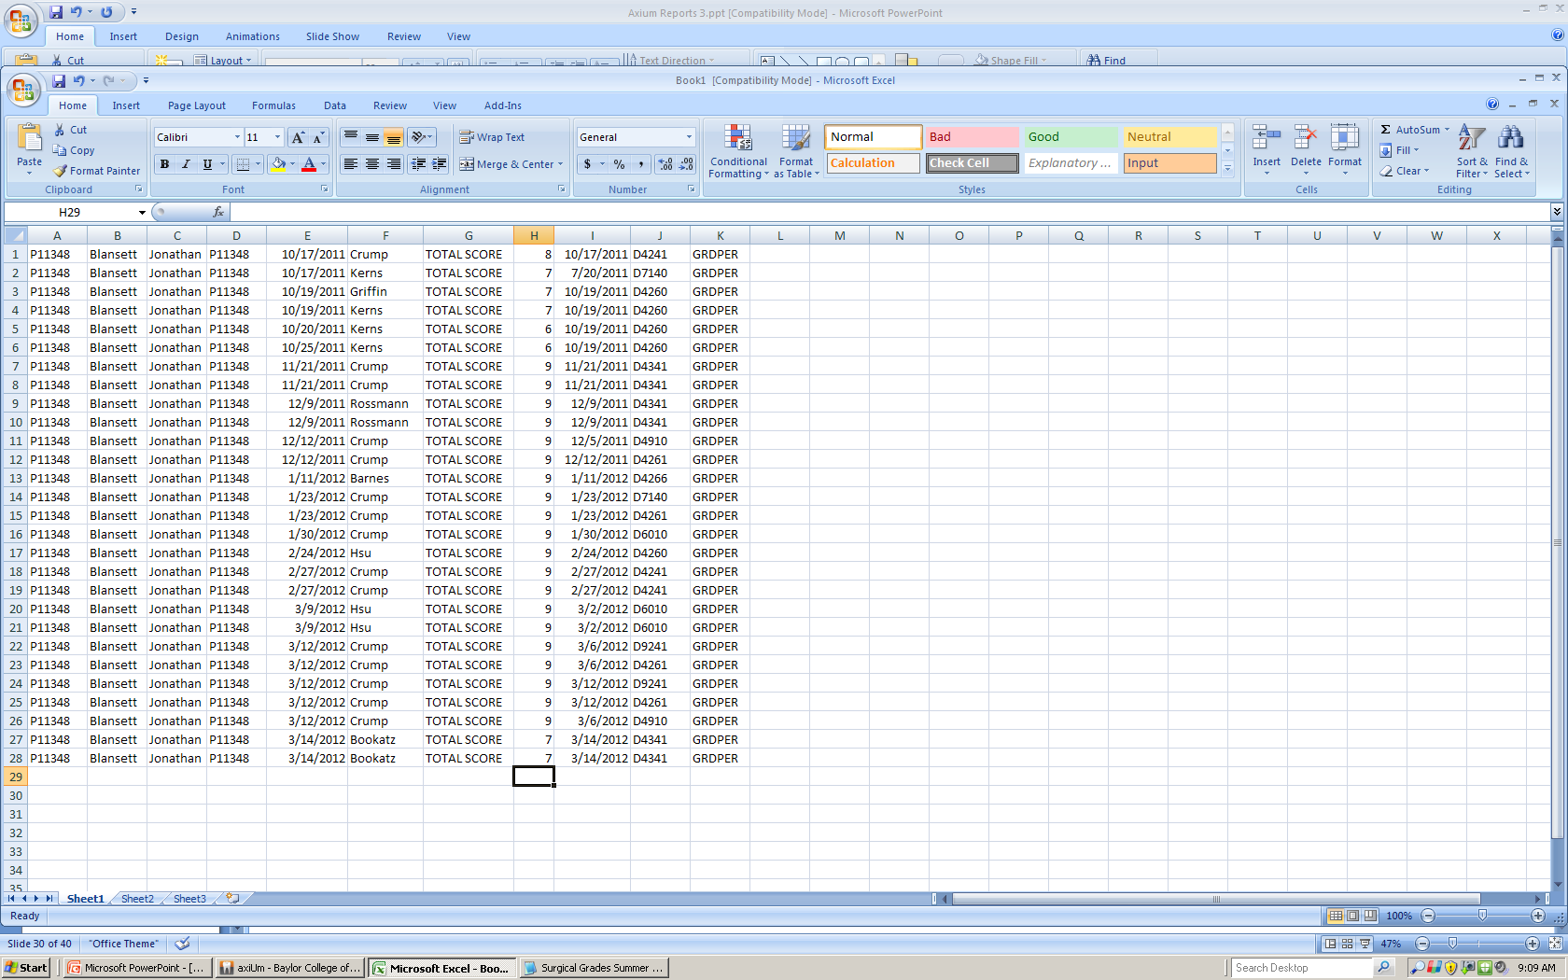
Go to “H” column

Slide 36

Click arrow to right of “Auto Sum”

Slide 37
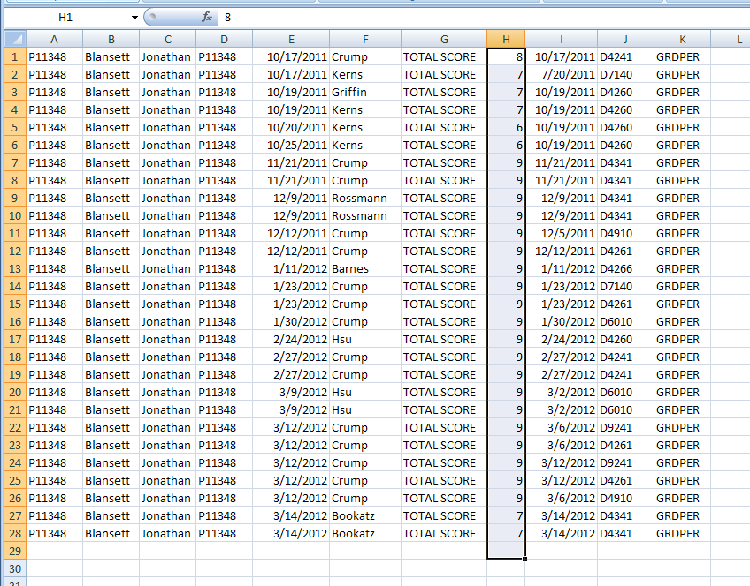
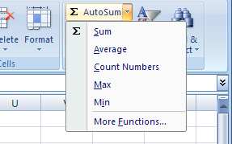
Highlight the “H” column and then click “Average”

Slide 38
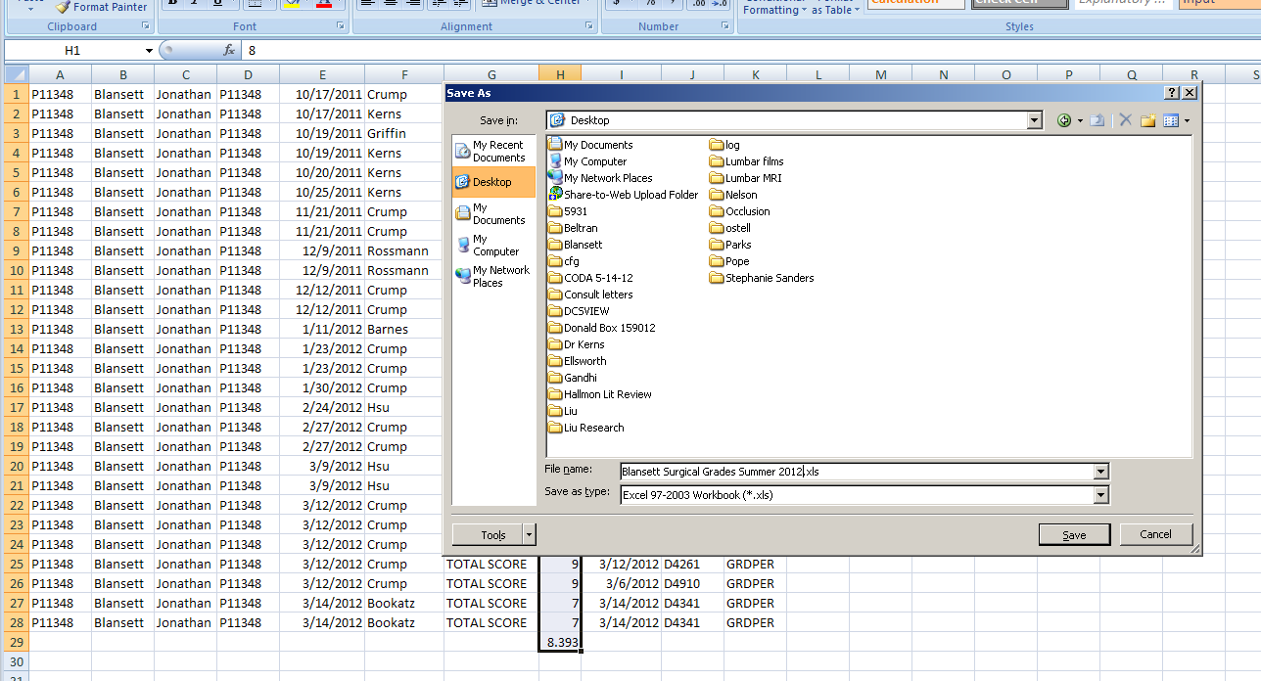
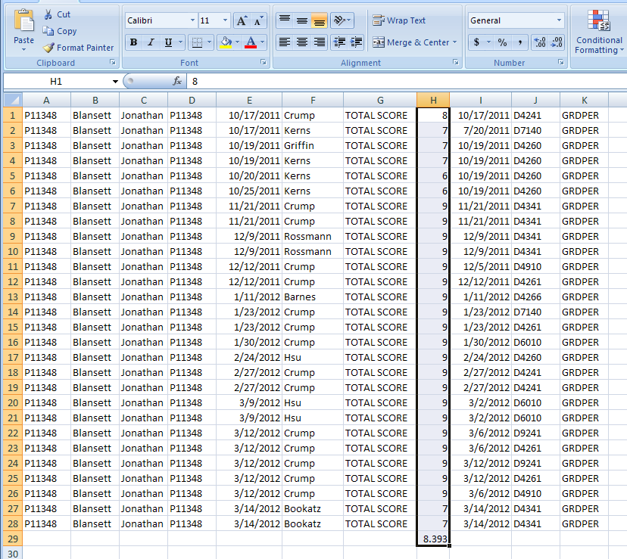
Hit “Enter” Then save as Excel Spreadsheet with Resident name.

Slide 39
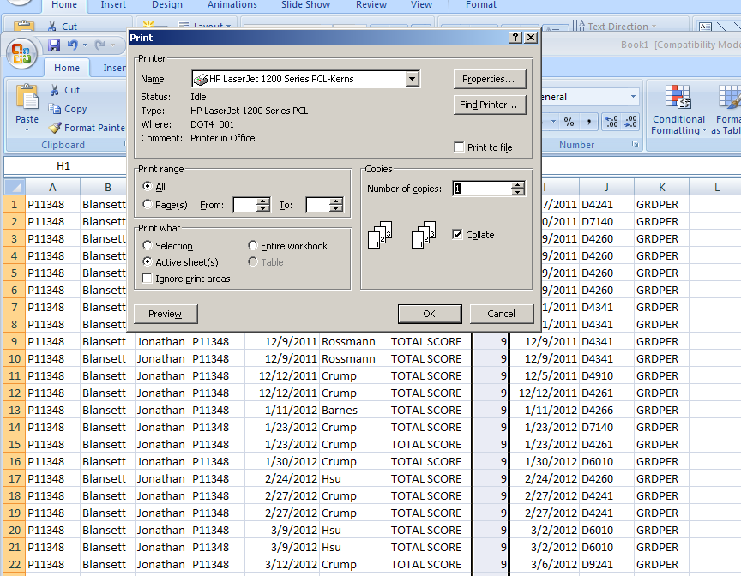
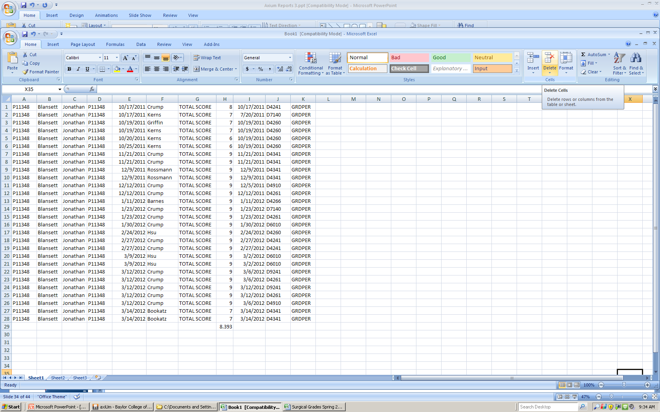
Go to your printer and print a clinical report for CODA reviewer (Landscape)

Slide 41
Axium Report
Makes it easy for me to write an objective evaluation of resident clinical performance
Your report documents multiple faculty evaluating residents
You define what procedures you want evaluated
Faculty answers “yes” or “no” facts….it makes harder for residents to argue with their grade on a procedure.
You also can see how your faculty grade and develop reports on that data.

Slide 42
Patient Portfolio

Slide 43
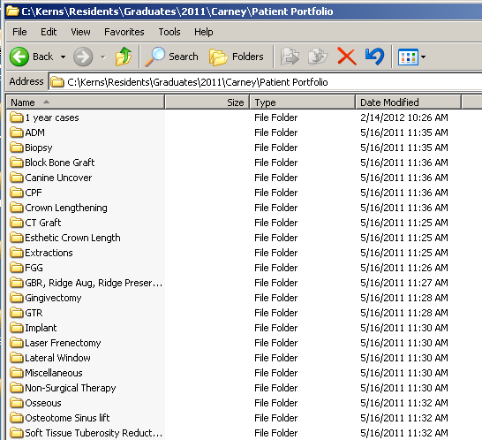
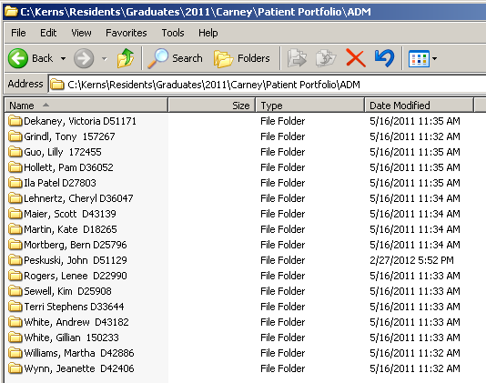

Slide 44
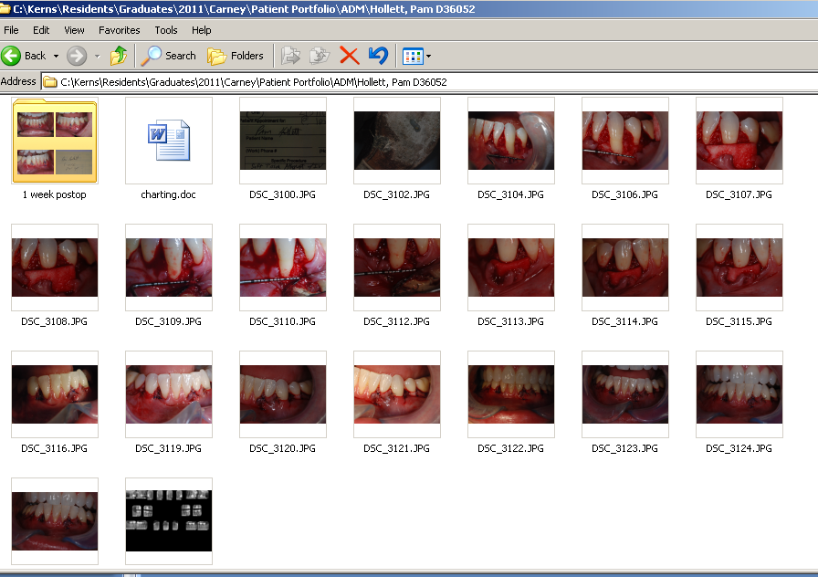
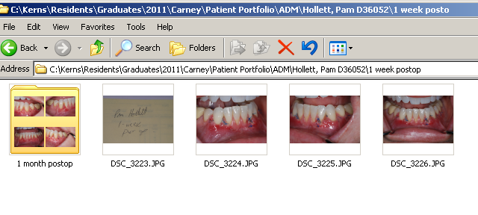

Slide 45
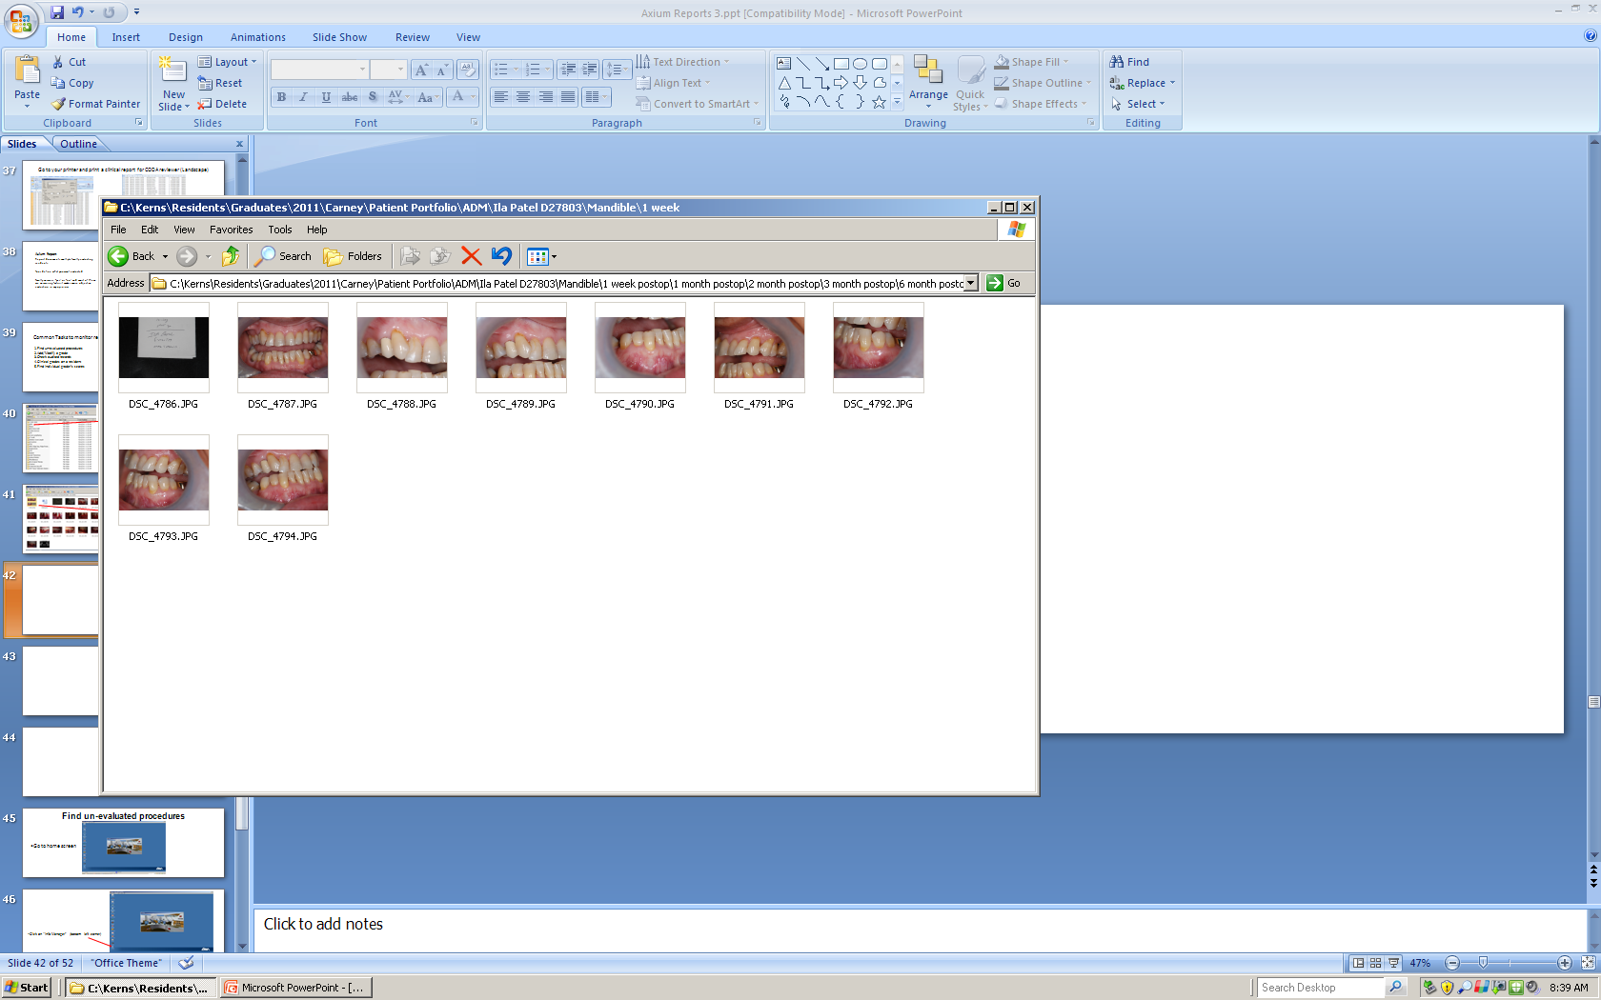

Slide 46
Copy the address and paste in Word
Creates a patient index

Slide 47
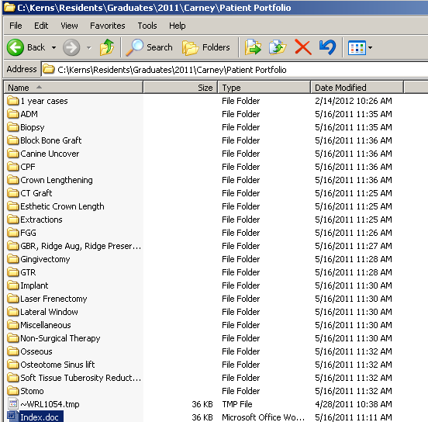
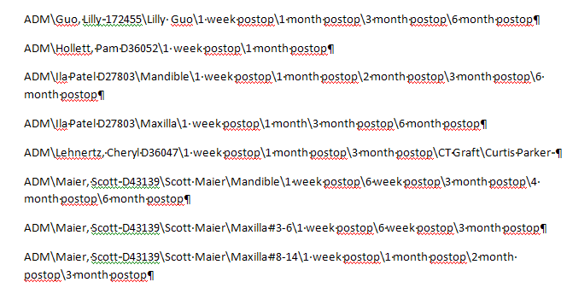

Slide 48
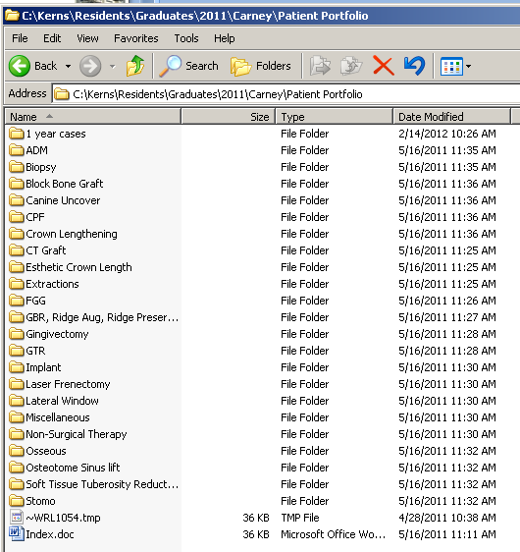
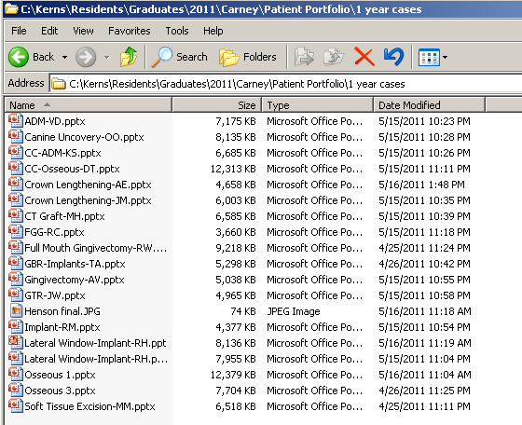
Mock Boards
1 year cases
Power Points

Slide 49
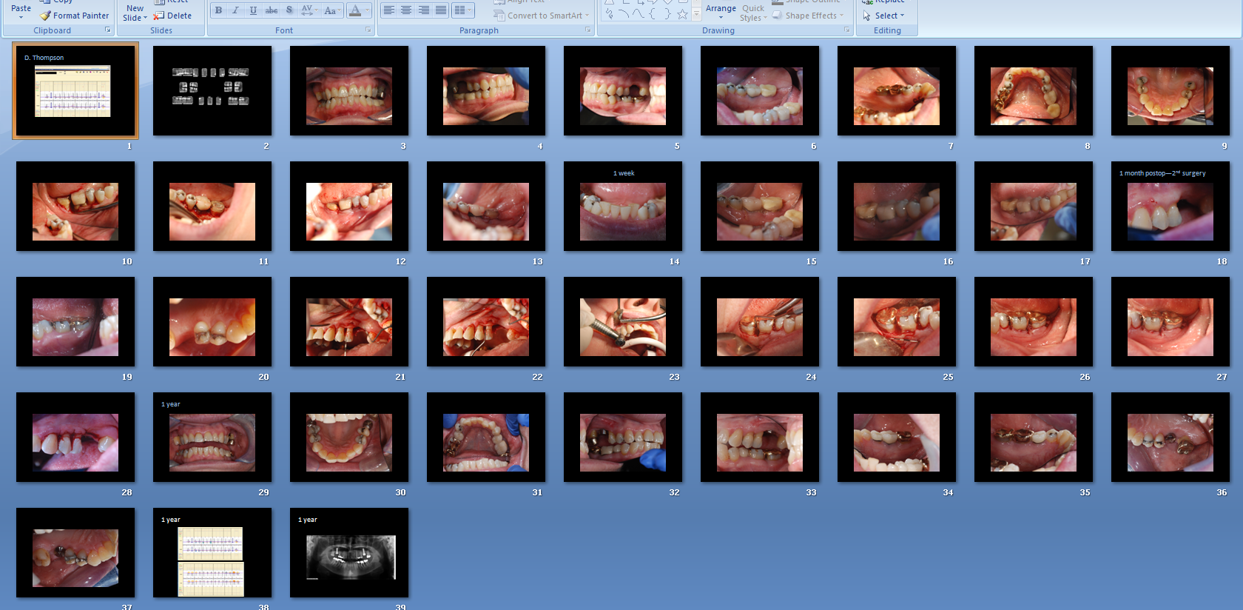

Slide 50
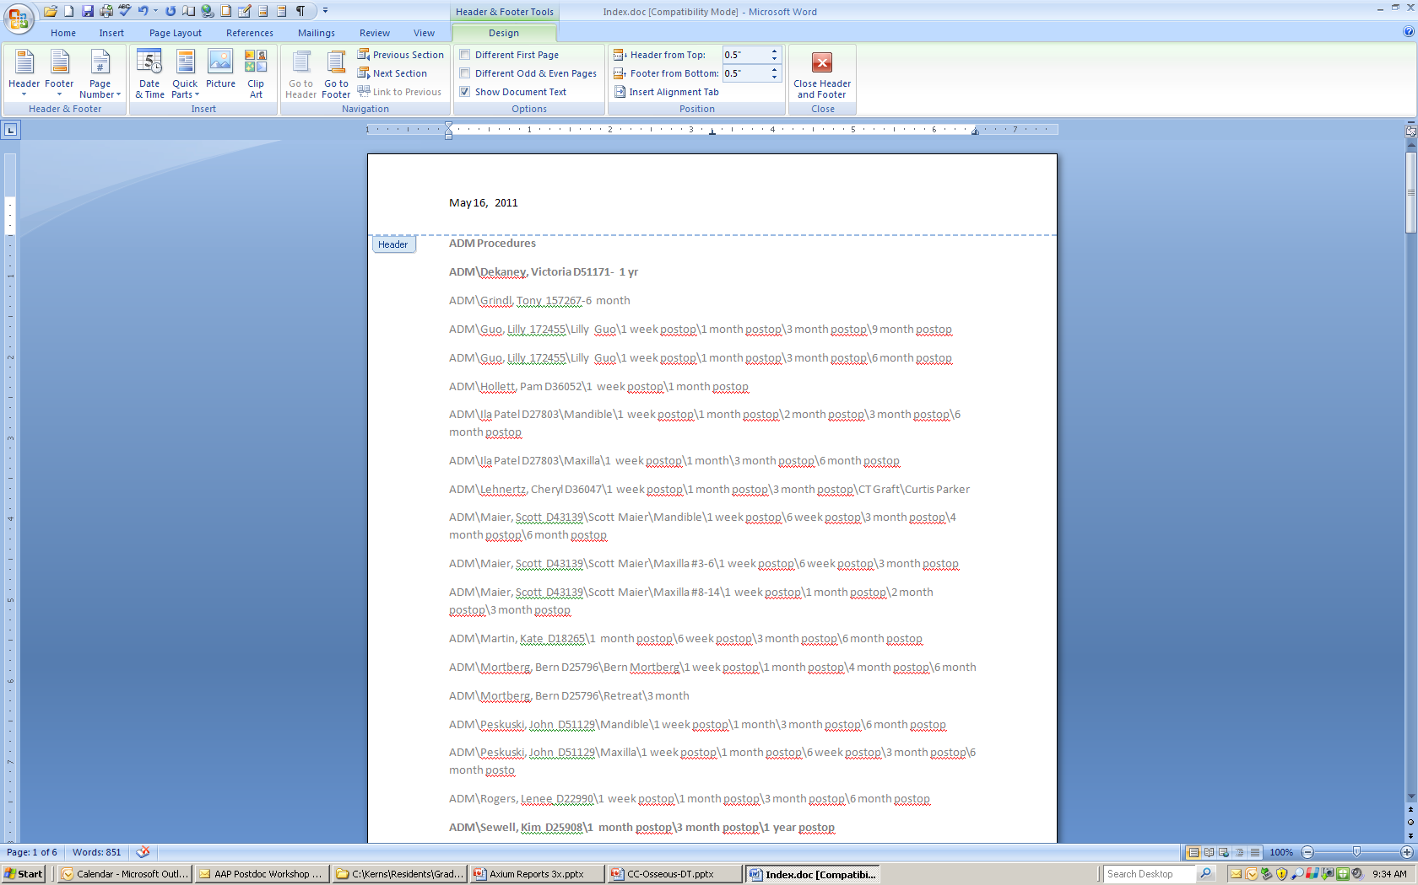
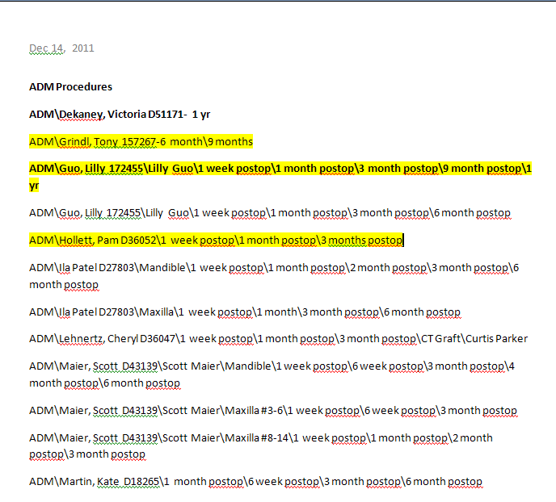

Slide 51

Verify 9 month post-op photo in portfolio

Slide 52

Common Tasks to monitor resident activity at Baylor
Find un-evaluated procedures
Add/Modify a grade
Check audited records
Clinical grades on a resident
Find individual grader’s scores

Slide 53
Find un-evaluated procedures
Go to home screen

Slide 54
Click on “Info Manager” (bottom left corner)

Slide 55
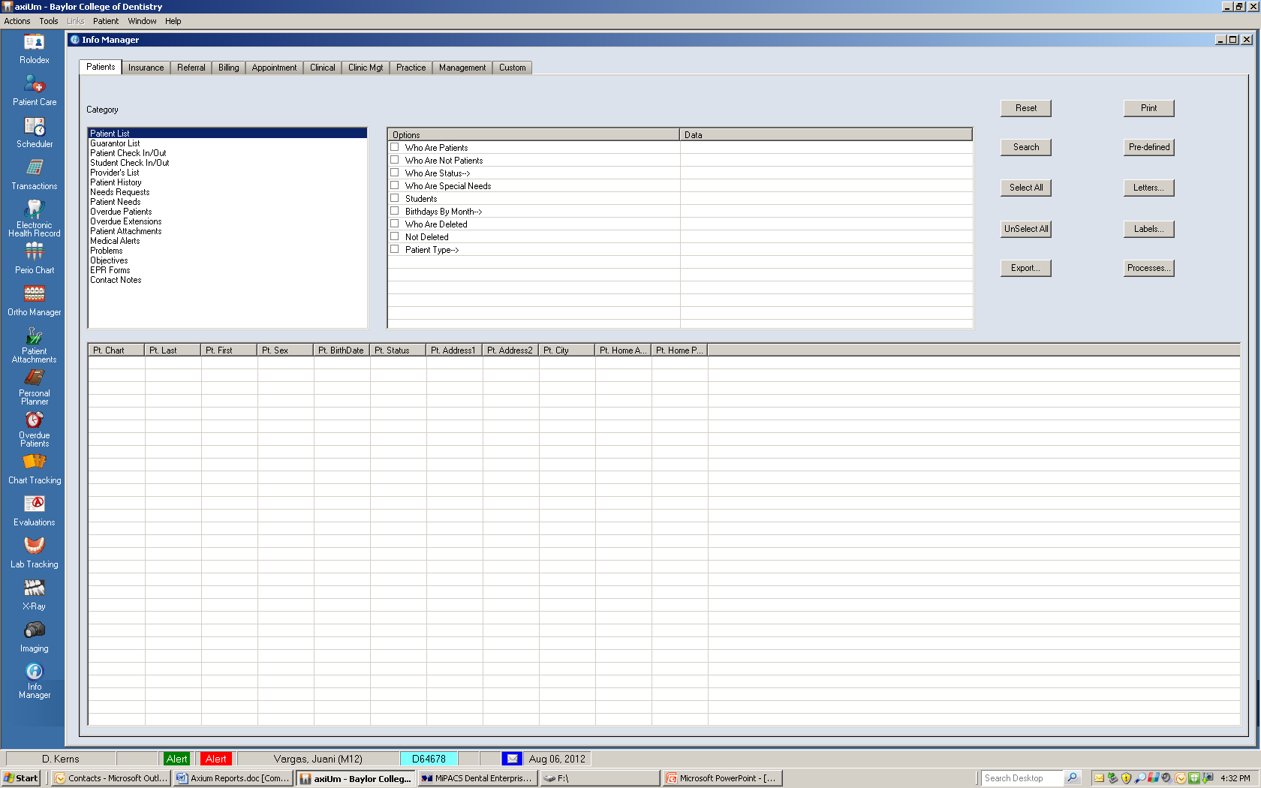
Click on “Evaluations”

Slide 56
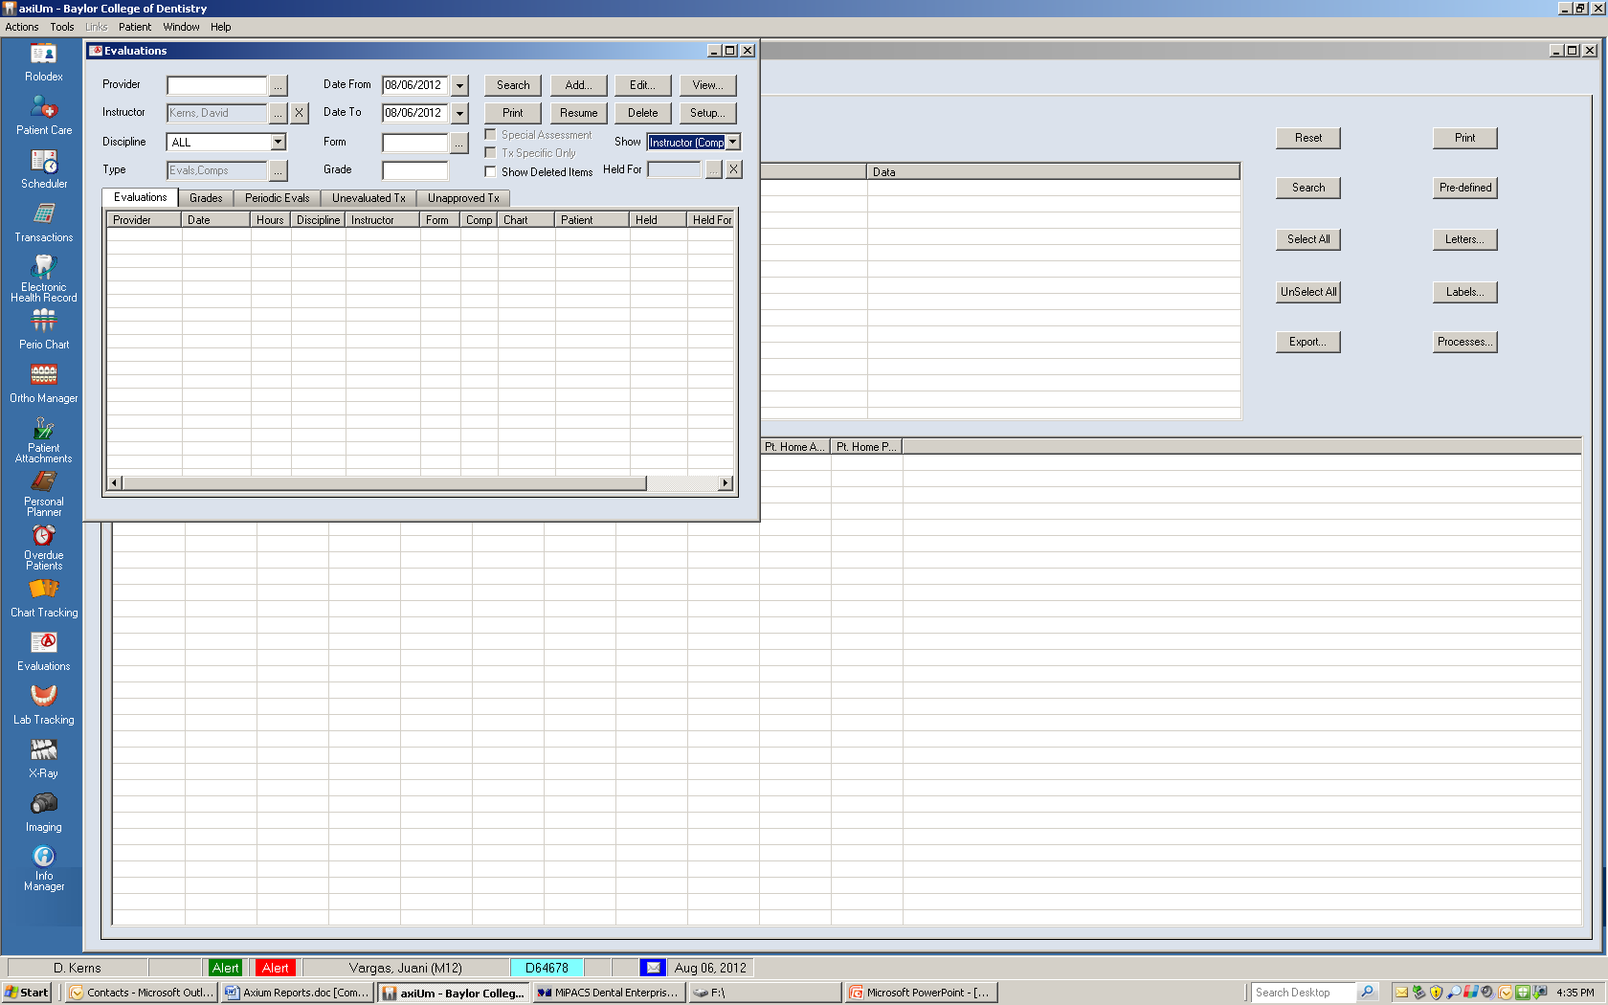
Click on “unevaluated tx”

Slide 57

Click on “Provider” (enter number)

Slide 58
Click on “date range” (from/to)

Slide 59
Click “Search”

Slide 60
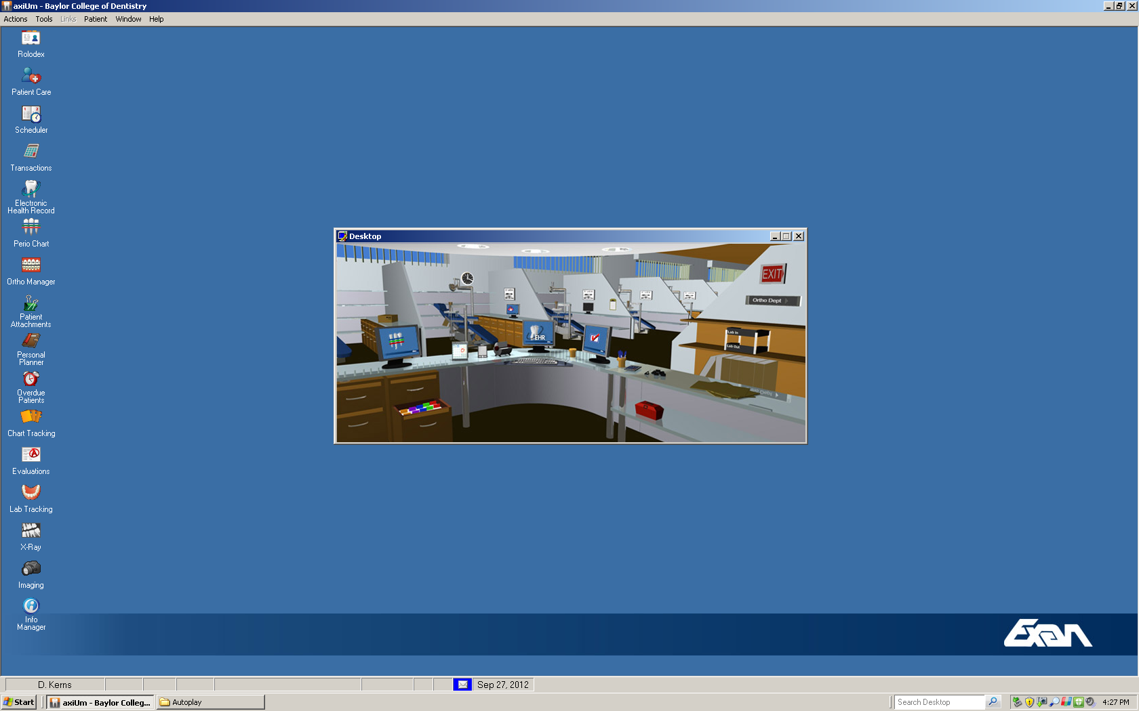
Data in Axium gives you lots of information, but you have to ask for it.

