Slide 1
Dentifrices & Mouthwashes
Spring 2022

Slide 2
Dr. Tobias Boehm, Western University of Health Science
Dr. Lea El Hachem
University of Texas Health San Antonio
Dr. Keerthana Sateesh
University of Missouri-Kansas City
Prepared by a Subgroup of the American Academy of Periodontology’s Education Committee
Dr. Binnaz Leblebicioglu
The Ohio State University
Dr. Nathalia Garcia
Southern Illinois University
Dr. Antonio Moretti University of North Carolina

Slide 3
Thank you to TePe Oral Health Care, Inc. for sponsoring AAP Education Access

Slide 4
Dentifrices

Slide 5
Dentifrices Overview
Dentifrice Definition
Ideal Properties of Dentifrices
Components
ADA Seal of Acceptance
Types of Dentifrices
Natural Products
Clinical Considerations
Case Studies
Click the links to go to a topic

Slide 6
Dentifrice Definition
Dentifrice or toothpaste is a substance used with a mechanical device (toothbrush) to clean teeth, tongue and gingiva.
Dentifrices can be utilized for their various properties. While most dentifrices are utilized for their cleaning effect, there are specific dentifrices that are utilized for their therapeutic and or cosmetic properties.
Dentifrices come in paste or gel form.

Slide 7
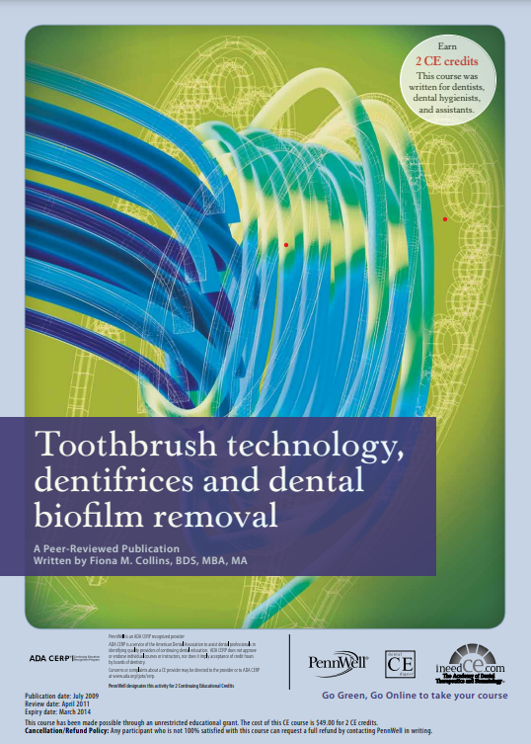
Desirable Properties of Dentifrices
Prevent plaque formation
Disrupt plaque and optimize plaque removal
Include agents that prevent demineralization and aid remineralization
Prevent and reduce periodontal inflammation and disease
Should not be an irritant to oral tissues
Prevent or reduce halitosis
Be effective without damaging the tooth surface or gingiva
https://dentalacademyofce.com/courses/oral-hygiene-recommendations-in-the-age-of-dr-google-an-evidence-based-approach-for-dental-professionals/

Slide 8
Main Components of Dentifrices
Cleansing and polishing agents (10-40%)
Humectants (20-70%)
Water (5%-30%)
Binders (1%-2%) or gelling agents
Detergents (1% - 3%) or surfactants or foaming agents
Preservatives (2%-3%)
Flavoring Agents (approx 2%)
Sweeteners (2%-3%)
Coloring or dye agents (2%-3%)

Slide 9
Cleaning & Polishing Agents
Cleaning (abrasive) Agents | Polishing Agents
Aluminum | Silicas
Calcium | Carbonates
Tin | Phosphates
Back to Components

Slide 10
Humectants
Sorbitol - maintain moisture
Mannitol - prevent evaporation
Glycerin - prevent hardening
Propylene glycol - increase shelf life
Back to Components

Slide 11
Binders or Gelling Agents
Binders
Natural gums - thickening agent
Seaweed extracts – used as a stabilizer
Synthetic cellulose - prevents solids from settling out
Back to Components

Slide 12
Surfactant (Foaming Agent)
Sodium Lauryl sulfate
Stable/Compatible
Some antibacterial properties
Flavor easy to mask
Low surface tension
Back to Components

Slide 13
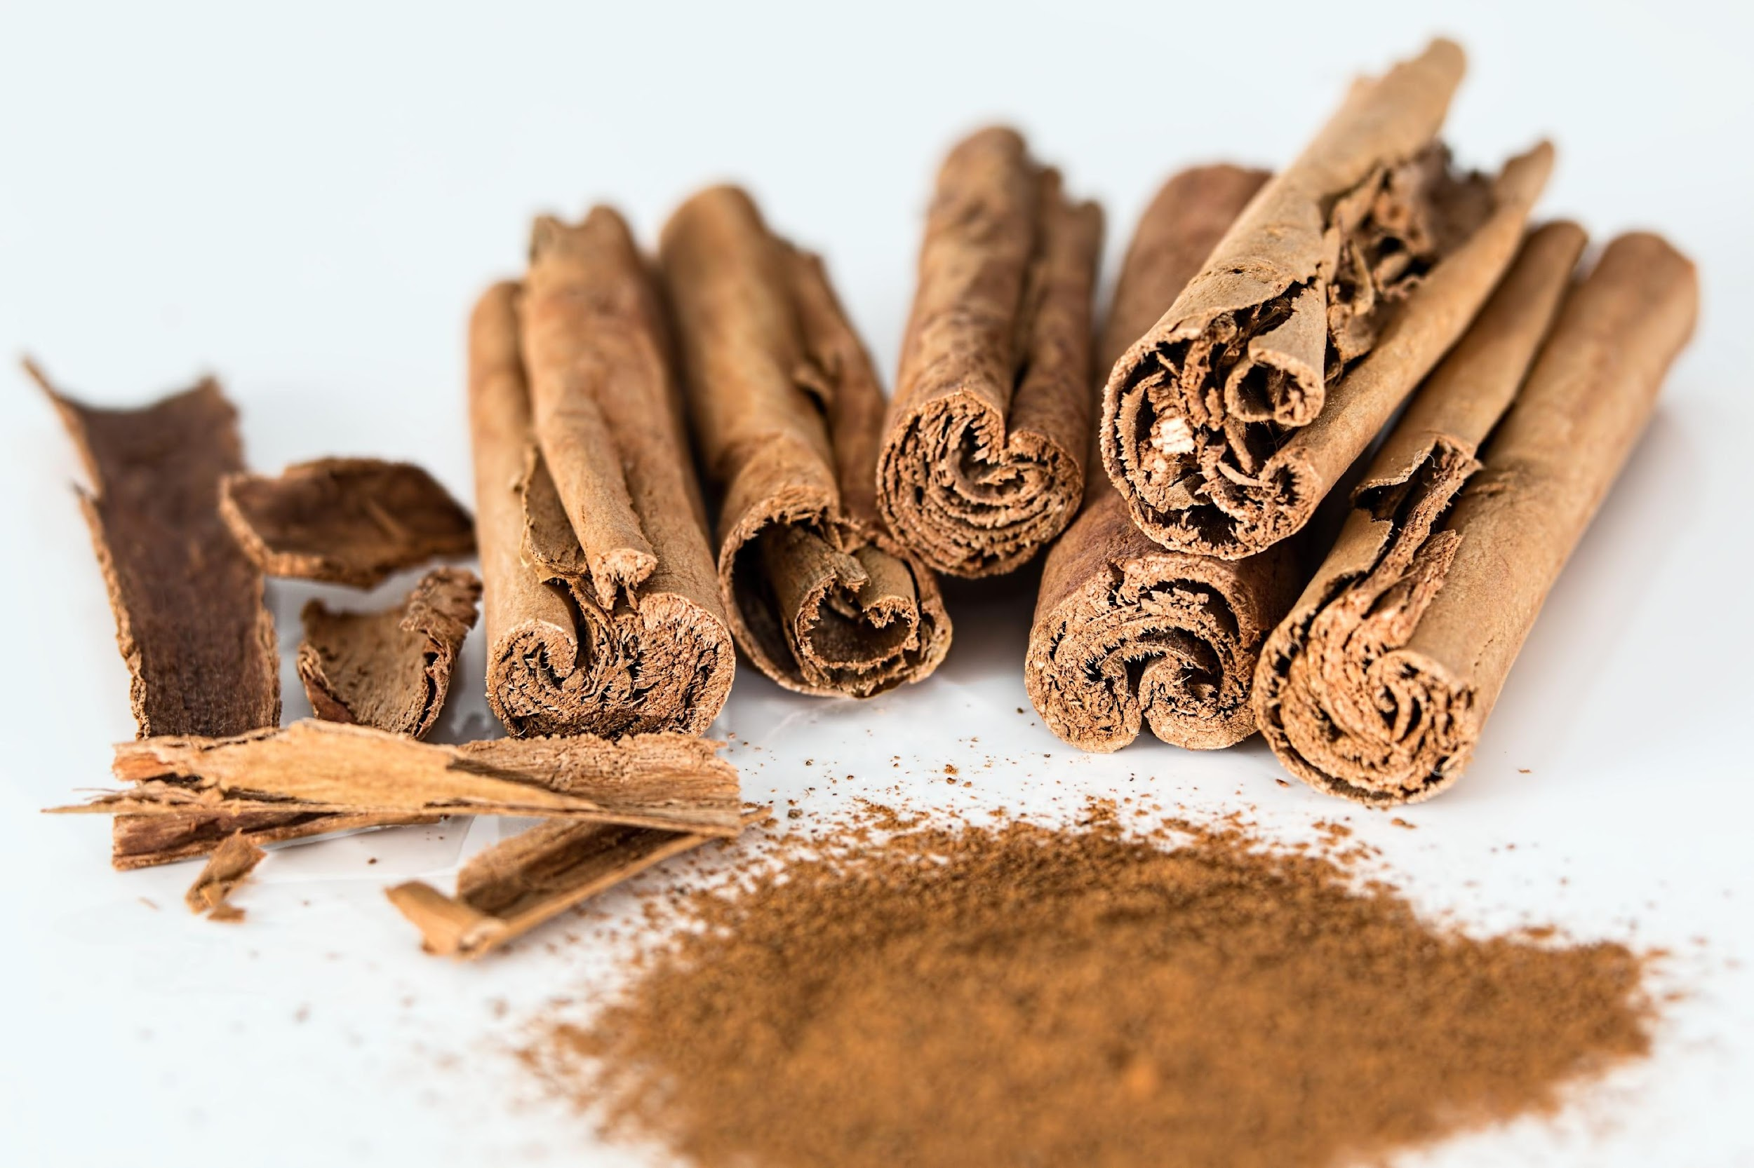
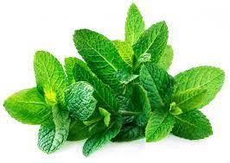
Flavoring Agents
Flavor Requirements:
Pleasant
Immediate
Long-lasting
Synthetic Flavors:
Spearmint
Wintermint
Vanilla
Cinnamon
Peppermint
Citrus
Essential Oils:
Thymol
Menthol
Eucalyptol
Methyl salicylate
Back to Components

Slide 14
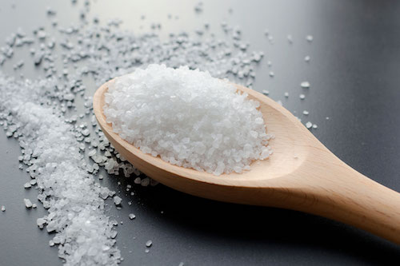
Sweetening Agents
Early Sweeteners:
Sugar
Honey
Non-Cariogenic Sweeteners:
Saccharin
Cyclamate
Sorbitol*
Mannitol*
Glycerin*
Xylitol
* Agents that serve as humectants
Back to Components

Slide 15
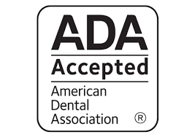
ADA Seal of Acceptance
Requirements:
Studies demonstrating safety & effectiveness
At least 6 months in length
Demonstrate statistically significant reductions in both plaque & gingivitis
FDA-approved ingredients
Assured purity & uniformity
Packaging and advertising claims that are supported by science
All ADA Accepted toothpastes contain Fluoride
No ADA Accepted toothpastes contain sugar

Slide 16
Types of Dentifrices
Anti-Caries Dentifrices
Desensitizing Dentifrices
Potassium Nitrate
Stannous Fluoride
Amorphous Calcium Phosphate
Anti-Gingivitis & Anti-Plaque Dentifrices
Triclosan (for historical reference)
Stannous fluoride
Natural/Herbal Dentifrices
Click the links for additional information

Slide 17
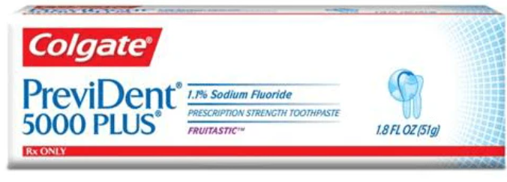
Anti-Caries
Anti-Caries
Fluoride is the most common therapeutic agent
Most OTC dentifrices have approximately 1000 ppm
Prescription F dentifrices have 5000 ppm fluoride content
Mechanism of action: Acts by being incorporated to the tooth substrates (enamel and dentin) rendering teeth more resistant to acid attack associated with cariogenic bacteria and diet.
Types of Fluoride
Sodium Fluoride (NaF) -0.22% at 1,100 ppm
Sodium Monofluorophosphate (MFP) -0.76% at 1,000 ppm
Stannous Fluoride (CnF2) -0.4% at 1,000 ppm
Prescription strength dentifrice- Sodium Fluoride at 5000 ppm
Back to types of dentifrices

Slide 18
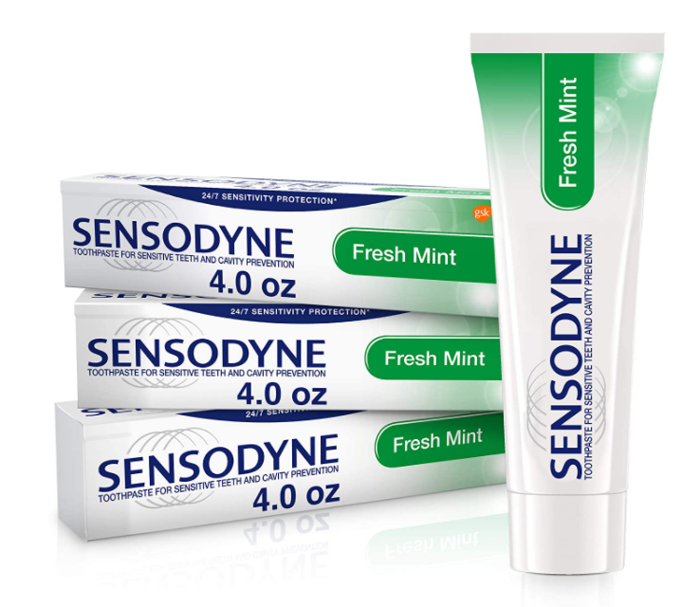
Dentifrices with Desensitizing Properties
Potassium salts
By depolarization of nerve endings
While they are effective, the relief only tends to last as long as the product is used
Back to types of dentifrices

Slide 19
Desensitizing Ingredients
Stannous fluoride
Act by tubular occlusion
SNF2 products are successful desensitizers by precipitating the stannous (tin) ion to occlude the dentinal tubules. SnF2 dentifrices and gels are proven to effectively relieve dentinal hypersensitivity and can be used long term.
Amorphous Calcium Phosphate (ACP)
Dentifrice designed to deliver calcium and phosphate salts have provided relief from sensitivity greater than the control product without ACP
ACP and fluoride provide semi-permanent occlusion with fluorapatite
ACP provides long lasting relief
Back to types of dentifrices

Slide 20
Anti-Plaque & Anti-Gingivitis Properties
Triclosan (discontinued)
Stannous Fluoride
Colgate Total and Crest Pro-Health are the only two dentifrices with antiplaque and anti-gingivitis properties accepted by the ADA
Back to types of dentifrices

Slide 21
Triclosan (Tcs)
Triclosan (Tcs; 2,4,4’–trichloro-2′-hydroxy-diphenyl)
Broad-spectrum antimicrobial agent
Additional Mechanism of Action:
Anti-inflammatory effects because of its inhibition of the cyclooxygenase/lipoxygenase pathway of arachidonic acid metabolism
Various formulations of this dentifrice used to be available
S Salzer et al. Comparison of triclosan and stannous fluoride dentifrices on parameters of gingival inflammation and plaque scores: A systematic review and meta-analysis. Int J Dent Hygiene 13, 2015; 1–17.
Back to types of dentifrices

Slide 22
Triclosan (Tcs)
The environmental and health effects of Tcs have been widely discussed.*
Some animal studies have demonstrated an alteration in hormone regulation. Furthermore, Tcs might influence bacterial resistance.
Tcs used to be included in many products in addition to dentifrices, such as soaps, deodorants, toys and kitchen utensil.*
Currently, triclosan-containing dentifrices are no longer available in the USA.
*FDA. Triclosan: What Consumers Should Know. In: Administration USFaD, ed. 2012. 61 SCCP SCoCP-. Opinion on triclosan – COLIPA P32. 2009
Back to types of dentifrices

Slide 23
Stannous Fluoride (SnF2)
First introduced in the 1950s
Due to tooth staining and bitter taste, it is reformulated as stabilized SnF2
Various formulations of dentifrices with Stannous Fluoride are available
It is shown to reduce gingival inflammation and bleeding through its effect as a broad-spectrum antimicrobial agent
It also manages and prevents dental caries by promoting enamel mineralization
S Salzer et al. Comparison of triclosan and stannous fluoride dentifrices on parameters of gingival inflammation and plaque scores: A systematic review and meta-analysis. Int J Dent Hygiene 13, 2015; 1–17.
Back to types of dentifrices

Slide 24
Dentifrices with Natural/Herbal Ingredients
In the recent years, there has been an increased preference for natural remedies/herbal products.
Several herbs/natural products have been studied. A few are listed on the right side of the screen.
Aloe Vera
Neem
Miswak
Tea tree oil
Turmeric
Back to types of dentifrices

Slide 25
Dentifrices with Natural/Herbal Ingredients
Aloe Vera - used for its natural bactericidal properties.
Gel of the Aloe Vera leaf has properties such as immuno-simulation, anti-inflammatory effects, wound healing, antibacterial, anti-fungal and anti-cancer action.
Studies have shown mixed results.
A recent study showed a significant reduction in plaque and gingivitis with the use of a dentifrice containing aloe vera however the results were not statistically significant when compared to a fluoride dentifrice*
*The Effect of Commercial Toothpaste Containing Aloe vera on Dental Plaque and Gingivitis: A Double-Blind Randomized Clinical Trial Ousama Aziz Ibrahim, Ahmed Ali Mohsin, Mohammad Hasan Alhammashi, Jafar Sadik Jafar. International Medical Journal Vol. 28, Supplement No. 1, pp. 80 - 82 , June 2021
Back to types of dentifrices

Slide 26
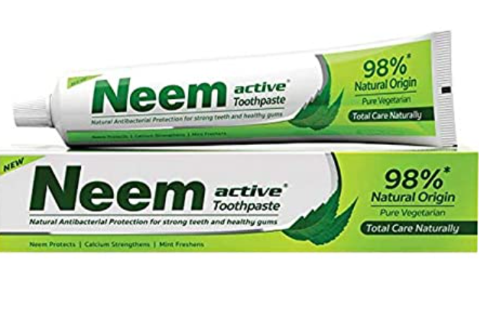
Dentifrices with Natural/Herbal Ingredients
Neem has been used in treatment of gingivitis and periodontitis.
Anti-inflammatory action by inhibiting prostaglandin E and 5HT thus reducing inflammation.
Azadirachtin in Neem contributes to its antibacterial property by destroying bacterial cell wall.
A double-blind controlled trial, use of Neem containing dentifrice provided a significant reduction of dental plaque accumulation and improved gingival health compared to a control dentifrice.*
*Abhishek KN, Supreetha S, Sam G, Khan SN, Chaithanya KH, Abdul N. Effect of Neem containing Toothpaste on Plaque and Gingivitis—A Randomized Double Blind Clinical Trial. J Contemp Dent Pract 2015;16(11):880-883.
Back to types of dentifrices

Slide 27
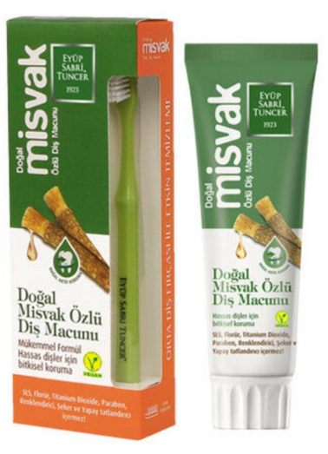
Dentifrices with Natural/Herbal Ingredients
Miswak is derived from salvadora persica, a small tree or shrub with a spongy stem and root, which is easy to crush between the teeth.
It is inexpensive and has been reported to have anti-plaque and many therapeutic pharmacological properties.
The efficacy of a miswak extract-containing toothpaste (salvadora persica) on gingival inflammation was compared with that of herbal and conventional toothpaste. The miswak extract-containing toothpaste showed similar effect as the herbal toothpaste and can be safely used for domestic oral hygiene in patients with gingivitis.*
*Azaripour et al. Effectiveness of miswak extract-containing toothpaste on gingival inflammation. A randomized control trial. Int J Dent Hyg Aug; 15(3):195-202
Back to types of dentifrices

Slide 28
Clinical Considerations (Undesirable Side Effects)
Almost any dentifrice can cause contact stomatitis, also known as dentifrice stomatitis. Symptoms can include burning sensation, tissue irritation, vesicle formation and tissue sloughing
Ingredients such as Sodium Lauryl Sulfate (SLS) is linked to this reaction as it enhances the permeability
A few ingredients in dentifrice added as “anti-calculus” are associated with a higher burning sensation of the gingiva and oral mucosa.

Slide 29
Case Studies

Slide 30
What would you add to the following patients’ oral health regimen?
Recommend a dentifrice that works well as an adjunct
Click the link for additional information

Slide 31
Case Study 1
Patient Information
69-year-old female
Chief Complaint: My former dentist told me I have new cavities at every visit.
Background and/or Patient History
Medication: Furosemide for hypertension Social history: Recently moved to the area. First dental appointment in a while
Case Courtesy: Dr. Jessica Scully
UMKC Adv Periodontics

Slide 32
Case Study 2
Patient Information
60-year-old female
Chief Complaint: My teeth are very sensitive
Review a few dentifrices that are effective in controlling dentin hypersensitivity
Case Courtesy: Dr. Kiran Arora
UMKC Adv Perio

Slide 33
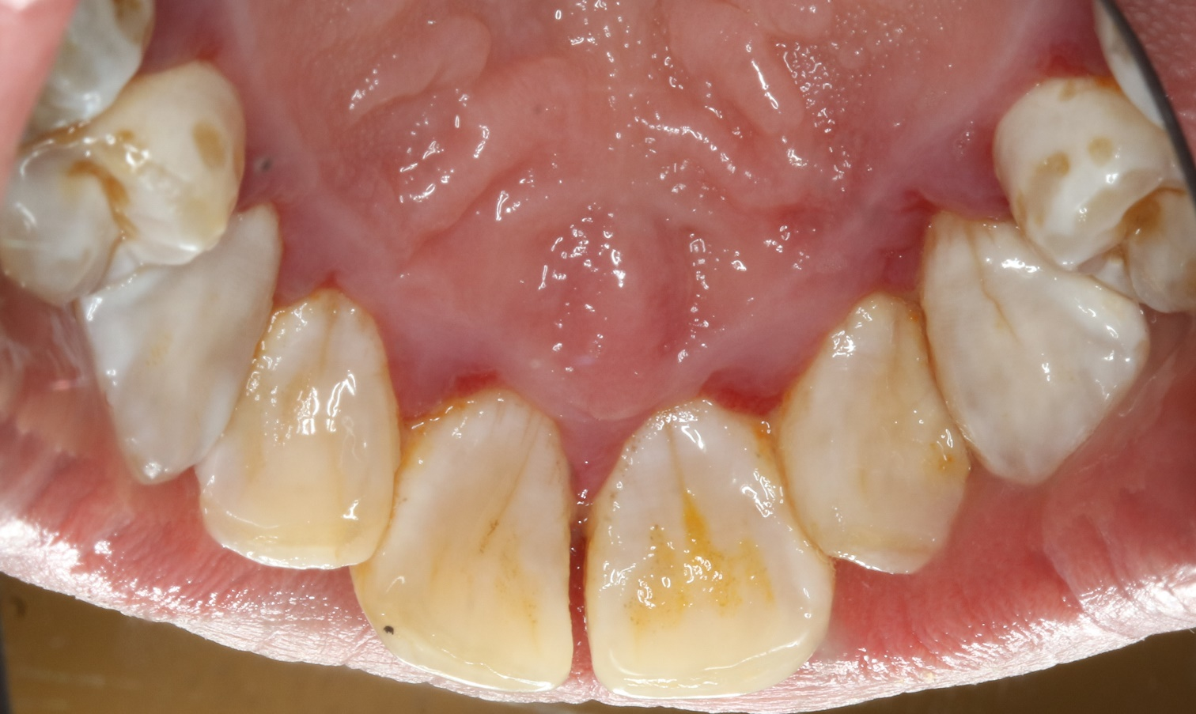
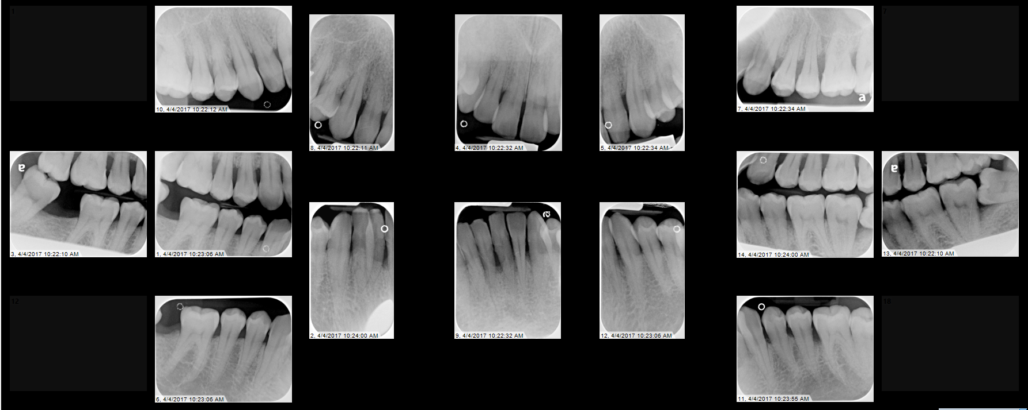
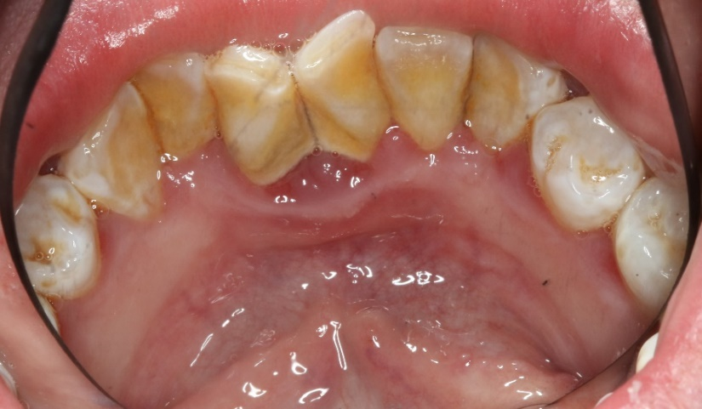
Case Study 3
Patient Information
45-year-old female
Chief Complaint: My gums bleed when I brush
Background and/or Patient History
Smoker with a 20-pack year history
Along with non-surgical therapy, what dentifrice will you recommend to this patient?
Case Courtesy: Dr. Rex Livingston.
UMKC Adv Periodontics

Slide 34
Dentifrices - References
Darby and Walsh – Dental Hygiene: Theory and Practice; fifth edition 2020
https://dentalacademyofce.com/courses/2076/PDF/1103cei_toothbrush_rev1.pdf
S Salzer et al. Comparison of triclosan and stannous fluoride dentifrices on parameters of gingival inflammation and plaque scores: A systematic review and meta-analysis. nt J Dent Hygiene 13, 2015; 1–17.
*FDA. Triclosan: What Consumers Should Know. In: Administration USFaD, ed. 2012. 61 SCCP SCoCP-. Opinion on triclosan – COLIPA P32. 2009
Ousama Aziz Ibrahim, Ahmed Ali Mohsin, Mohammad Hasan Alhammashi, Jafar Sadik Jafar. The Effect of Commercial Toothpaste Containing Aloe vera on Dental Plaque and Gingivitis: A Double-Blind Randomized Clinical Trial . International Medical Journal Vol. 28, Supplement No. 1, pp. 80 - 82, June 2021
Abhishek KN, Supreetha S, Sam G, Khan SN, Chaithanya KH, Abdul N. Effect of Neem containing Toothpaste on Plaque and Gingivitis—A Randomized Double Blind Clinical Trial. J Contemp Dent Pract 2015;16(11):880-883.

Slide 35
Mouthwashes

Slide 36
Mouthwashes Overview
Definition
Formulation and Use
Ideal Properties
Active Ingredients
ADA Seal of Acceptance
Most Common Mouthwashes
Natural Products
Miscellaneous
Clinical Scenario
Click the links to go to a topic

Slide 37
Mouthwash Definition (Oral Rinse or Mouth-Rinse)
Defined as a liquid product that can be cosmetic, for a pleasant taste and temporary fresher breath, or therapeutic, with active ingredients to reduce halitosis, plaque, gingivitis or dental caries.
Therapeutic mouthwashes are frequently recommended as part of patient’s oral self-care plan, as an adjunctive to daily mechanical methods for reduction of plaque and gingivitis.
Back to Mouthwashes Overview

Slide 38
Formulation and Use
Mouthwashes have oral antiseptics
Inhibit the growth and development of the microbiota
Cause little or no oral or systemic toxicity
Active against a wide range of bacteria
Approximately half of the US population has used or uses mouthwashes daily.
General recommendation is for twice daily rinses, for 30 seconds.
Oral rinses reach inaccessible areas missed by mechanical methods.
These rinses, like dentifrices, have a limited effect on the subgingival pathogenic bacteria
Back to Mouthwashes Overview

Slide 39
Ideal Properties of Oral Rinses
Safe to use over long periods of time
Palatable to user
Inexpensive
Highly soluble and stable in storage
Effective
Broad spectrum of effectiveness
Adequate bioavailability to bacteria
Minimal side effects
Adequate retention
Back to Mouthwashes Overview

Slide 40
Most common active ingredients (Oral Antiseptics)
Chlorhexidine (CHX)
Essential Oils (EO)
Cetylpyridinium Chloride (CPC)
Back to Mouthwashes Overview

Slide 41
ADA Seal of Acceptance
Requirements for Nonprescription Mouthrinses
Studies demonstrating safety and effectiveness
With at least 6 months in length
Demonstrate statistically significant reductions in both plaque and gingivitis
FDA-approved ingredients
Assured purity and uniformity
Packaging and advertising claims that are supported by science
Back to Mouthwashes Overview

Slide 42
Most Common Mouthwashes

Slide 43
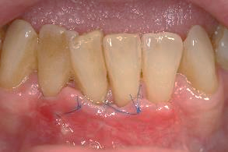
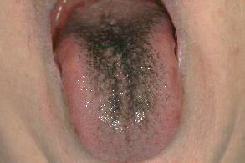
Chlorhexidine (CHX)
Available through prescription only in the USA.
Gold standard of therapeutic mouthwashes.
Most effective antiplaque and antigingivitis agent.
Antibacterial action through disruption of bacterial cell membrane, increasing permeability, cell lysis and death.
Superior substantivity (8-12-hour binding to oral tissues).
Side effects (all temporary and reversible):
Tooth and tongue staining
Unpleasant taste
Reduction in taste sensation
Increased calculus accumulation
Case documentation by Dr. Moretti
University of North Carolina

Slide 44
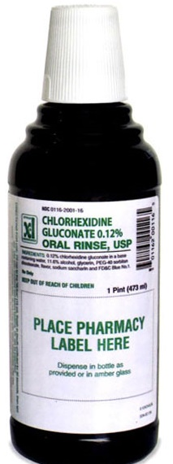
Chlorhexidine (CHX) Prescription
15mL (0.5 fl. oz.) dosage for 60 seconds bid for 14 days.
Rinse and do not swallow.
Allow a minimum of 30 minutes between rinsing with CHX and toothbrushing (either before or after) to avoid interaction with the detergent sodium lauryl sulfate from the dentifrice, which deactivates CHX.
After its use, wait to eat, drink or rinse for 30 minutes.
Brand names: Peridex, PerioGard, and Paroex

Slide 45
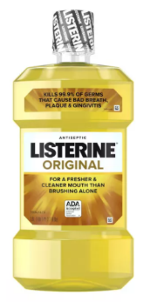
Essential Oils (EO)
Components of plants that contain phenolic compounds that destroy microorganisms by compromising the cell membrane and inhibiting enzyme activity.
Therapeutic Effects:
Prevents bacterial aggregation
Slows bacterial multiplication
Reduces bacterial load in oral cavity
Prevents biofilm maturation
Reduces pathogenicity of biofilm
Exerts anti-inflammatory benefit

Slide 46
Essential Oils (EO)
Suitable for long-term use due to:
No associated stain
Safe product
No changes produced in bacterial composition
No evidence of opportunistic oral pathogens
No evidence of antimicrobial resistance
There are multiple formulas combining EO.
One of the most studied mouthwashes, with evidence of effectiveness. However, CHX remains as the first choice for gingivitis reduction.

Slide 47
Cetylpyridinium Chloride (CPC)
Contains
Quaternary ammonium chemical compounds (which have antimicrobial properties)
Destroy microorganisms by interacting with the bacterial cell membrane, increasing permeability and losing its contents.
Bactericidal to Gram-positive bacteria
Moderately bactericidal to Gram-negative bacteria
Low substantivity when compared to CHX
Reduction in plaque and gingivitis has not been shown in long-term clinical studies

Slide 48
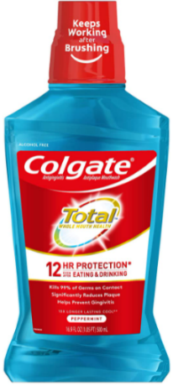
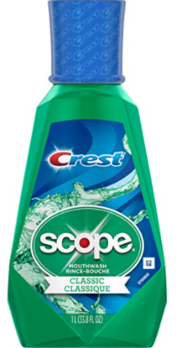
Cetylpyridinium Chloride (CPC)
Commercial rinses that have demonstrated benefit as an adjunct to mechanical plaque control for biofilm and gingivitis reduction:
Crest Pro-Health Rinse 0.07%
Colgate Total Rinse 0.075%
Scope Rinse 0.07%
Side effects, warnings, other benefits:
Increased tooth staining
CPC, like CHX, can be inactivated by sodium lauryl sulfate from dentifrices
Breath-freshening qualities and reduction of halitosis
Back to Mouthwashes Overview

Slide 49
Natural Products

Slide 50
Rationale
Healthcare providers are no longer the only source for oral health information due to internet and social media being readily available.
Many of these platforms promote lack of (1) alcohol, (2) artificial preservatives, (3) flavors and (4) colors.
US survey with 26,000 respondents: approximately 35% use herbal medicines.
Main reason to use herbal medicine: dissatisfaction with conventional medicine.
Herbal = plant-based
Most popular published trials for dentistry: mouthwashes and dentifrices.

Slide 51
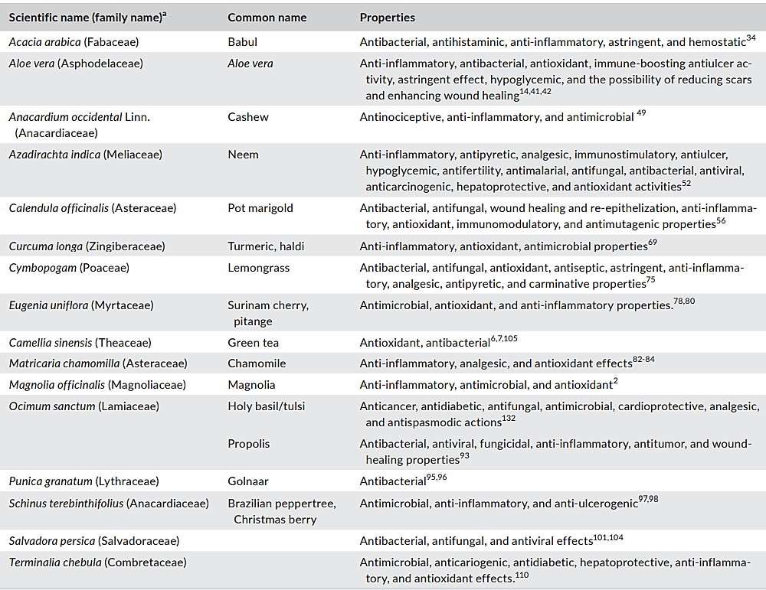
Source: Laleman and Teughels, 2020

Slide 52
Mouthwash Ingredients Undergoing Study
Chitosan
Teas
Salvadora persica
Taurolidine
Pomegranate
Edible oils
Aloe vera
Propolis
Sodium hypochlorite (bleach)
Turmeric
Neem tree products
Cinnamon
Algae
Witch hazel
Polyherbals

Slide 53
Natural Products
Many studies suggest positive effects on biofilm control and reduction of gingival inflammation.
Most studies don’t have adequate design (e.g., lack of proper control).
Duration of studies should be ideally 6 months or longer.
Adverse effects of these natural products need to be examined and reported in detail in the literature.
Difficult to draw firm conclusions from current studies.
Early evidence is encouraging but there is NOT enough evidence to shift from products approved by regulatory dental bodies.
Back to Mouthwashes Overview
Source: Laleman and Teughels, 2020

Slide 54
Miscellaneous Products

Slide 55
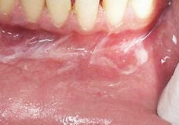
Alcohol Containing Mouthwashes
Contraindications
Recovering alcoholics
Individuals who are not able to expectorate
Patients being treated with head and neck radiation, with oral mucositis
Additional issues:
Individuals with sodium-restricted diets should be aware that some brands of mouthwashes may be significant sources of sodium.
Sodium lauryl sulfate (SLS) can cause sloughing of the mucosa
Case documentation by Dr. Moretti
University of North Carolina

Slide 56
Triclosan
Use restricted or banned in most countries, including the USA
Broad-spectrum antibacterial agent
In the US, manufacturers failed to provide the FDA conclusive proof regarding hormonal effects and antibiotic resistance
Unclear evidence of being hazardous to humans
Resistance and cross-resistance rates in community setting are low
Low environmental burden (0.03%)

Slide 57
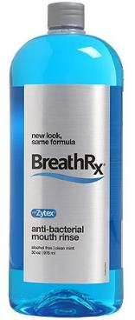
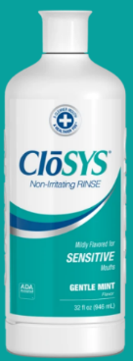
Chlorine Dioxide
Powerful oxidizing agent.
Popular as an oral malodor agent more so than anti-plaque or anti-gingivitis.

Slide 58
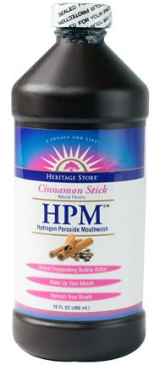
Hydrogen Peroxide
Combines tooth whitening and
reduction of gingival inflammation.
Not for long-term use due
to concerns with its side effects.

Slide 59
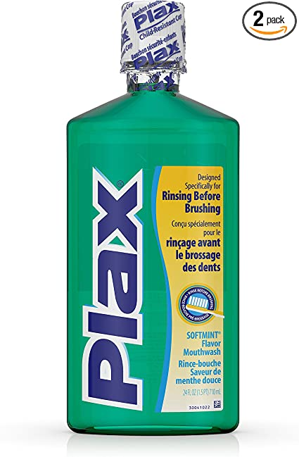
Pre-Brushing Mouthwash
Introduced in 1985.
Manufacturer claims a detergent action which removes part of the biofilm and softens the remainder for easy removal with toothbrushing.
Majority of clinical studies do
not support the use of pre-brushing
mouthwash to reduce both biofilm
and gingival inflammation.

Slide 60
Clinical Case

Slide 61
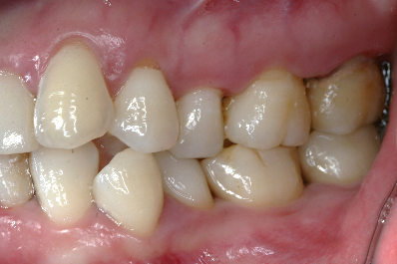
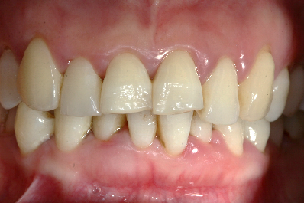
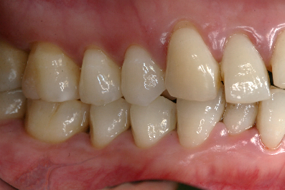
Patient Information
54-year-old Male
Chief Complaint: I have bleeding gums.
Background and/or Patient History
Dental Hx: negative for previous periodontal treatment
Diagnosis and Treatment
Diagnosis: Periodontitis Stage III Generalized, Grade B Treatment Provided: Education of patient regarding etiology of periodontal diseases OHI including the use of electric toothbrush and specific dentifrice (with stannous fluoride) and mouthwash (with essential oils) bid SRP + reevaluation of initial therapy Surgical therapy + reevaluation Periodontal Maintenance every 3 months
Case documentation by Dr. Moretti
University of North Carolina

Slide 62
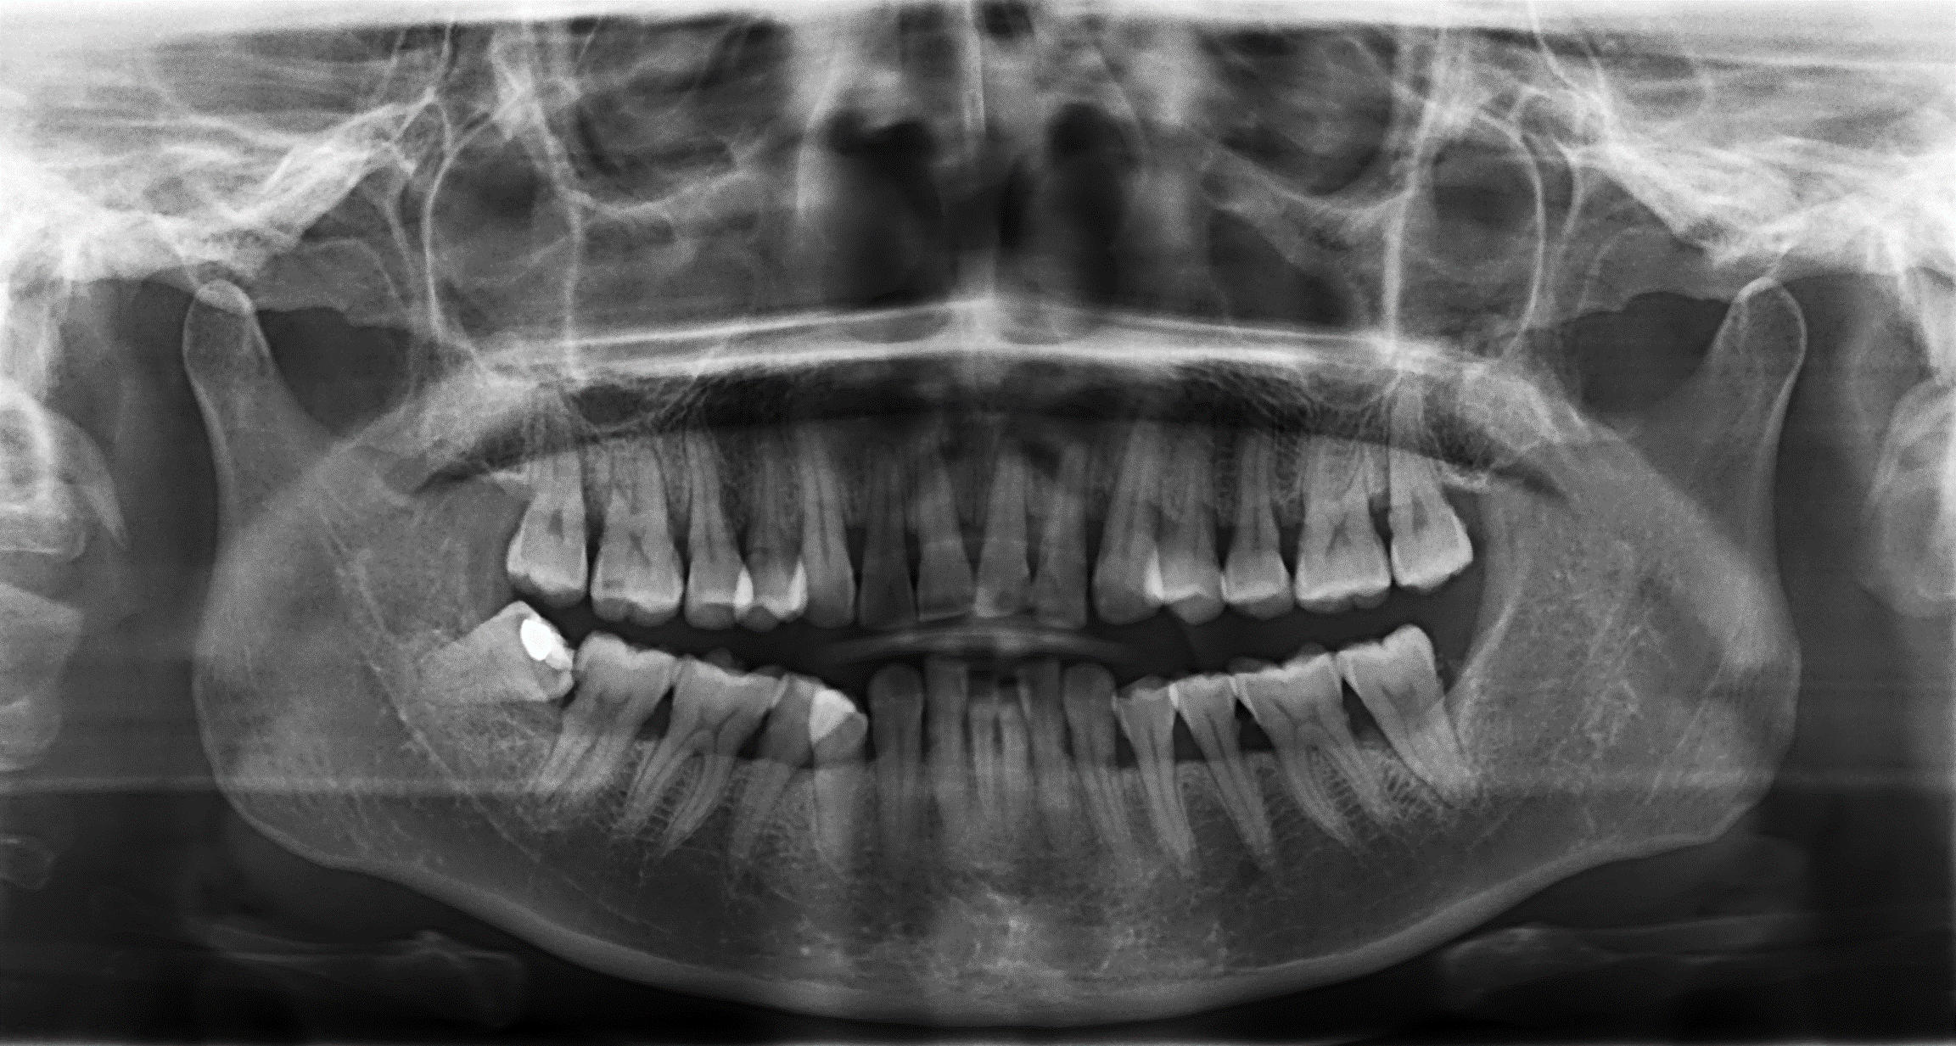
Radiographic Documentation

Slide 63
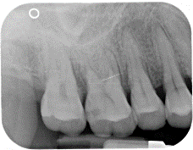
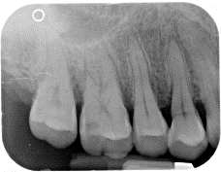
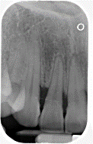
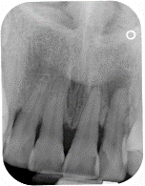
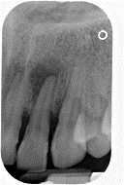
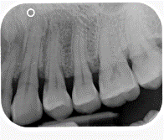
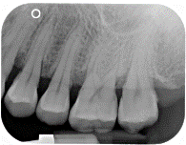
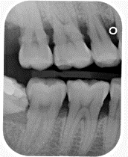
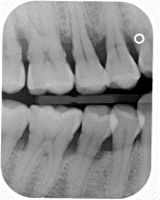
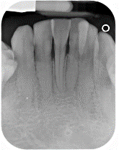
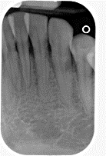
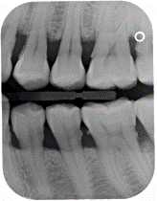
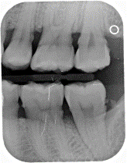
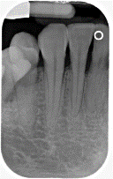
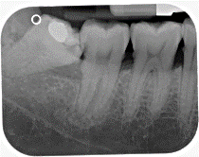
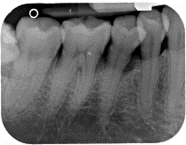
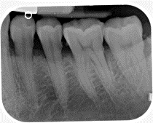
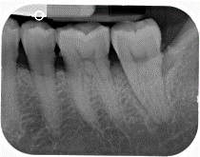
Radiographic Documentation

Slide 64
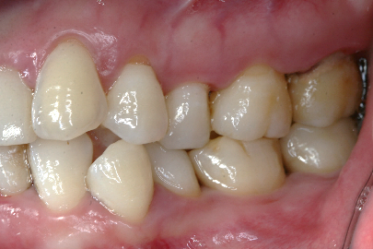
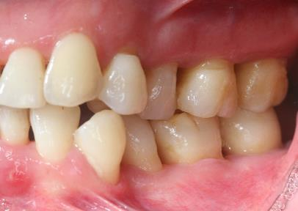
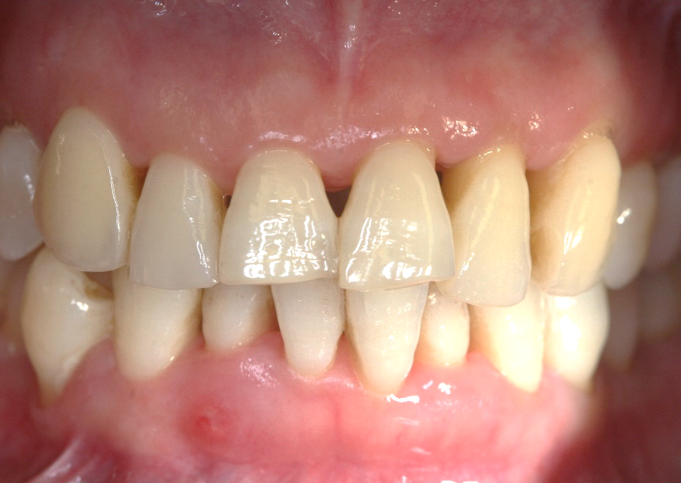
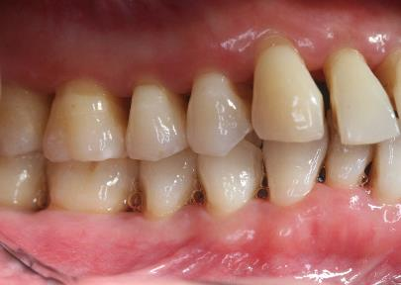
Pre-Treatment
Re-evaluation of Non-Surgical and Surgical Therapy

Slide 65
Mouthwashes - Book References
Darby and Walsh – Dental Hygiene: Theory and Practice; fifth edition 2020
Newman and Carranza’s Clinical Periodontology; thirteenth edition 2019

Slide 66
Mouthwashes - Articles
Serrano J et al. Efficacy of adjunctive anti-plaque chemical agents in managing gingivitis: a systematic review and meta-analysis. J Clin Periodontol 2015; 42 (Suppl.16):S106-S138. doi:10.111/jcpe.12331.
Figuero E et al. Mechanical and chemical plaque control in the simultaneous management of gingivitis and caries: a systematic review. J Clin Periodontol 2017; 44 (Suppl. 18): S116-S134. doi: 10.1111/jcpe.12674.
Figuero E et al. Efficacy of adjunctive anti‐plaque chemical agents in managing gingivitis: A systematic review and network meta‐analyses. J Clin Periodontol. 2019;46:723–739. https://doi.org/10.1111/ jcpe.1312.
Figuero E et al. Efficacy of adjunctive therapies in patients with gingival inflammation: A systematic review and meta-analysis. J Clin Periodontol. 2020;47:125– 143. https://doi.org/10.1111/jcpe.13244.
Laleman I, Teughels W. Novel natural product‐based oral topical rinses and toothpastes to prevent periodontal diseases. Periodontol 2000. 2020;84:102–123. https://doi.org/10.1111/prd.12339.
Scannapieco FA, Gershovich E. The prevention of periodontal disease—An overview. Periodontol 2000. 2020;84:9-13. https://doi.org/10.1111/prd.12330.

Slide 67
End of Presentation
Thank you to TePe Oral Health Care, Inc.
for sponsoring AAP Education Access

